Slide 1
2 Minutes for Future
Initiative of Scientists for Future
Dedicate some minutes during scientific presentations to climate change
Rise awareness and engagement among the scientific community
Motivate other scientists to do the same
2minutes4future.org
Notes:
SPEAKER NOTES:
2 Minutes for Future is an initiative of Scientists for Future. The idea is to dedicate a part of scientific presentations (seminar, lectures, conferences..) to raise awareness among the scientific community. The goal is to motivate other sceientists to engage and become active. Toward the end of the presentation there is a slide listing many different ways to engage for scientists (including joining 2minutes4future)
CREDIT: © Fabrizio Menardo, CC-BY-SA 4.0

Slide 2
The global temperature is rising
Notes:
SPEAKER NOTES:
In the last 100 years the average world temperature increased more than 1 °C, global warming accelerated in the last 30 years (0.7 °C increase).
CREDIT: © Fabrizio Menardo, CC-BY-SA 4.0
SOURCES:
Data from 1850 onward was obtained from HadCRUT4 (https://www.metoffice.gov.uk/hadobs/hadcrut4/). HadCRUT4 is a gridded dataset of global historical surface temperature anomalies relative to a 1961-1990 reference period. Data are available for each month since January 1850, on a 5 degree grid.
Citation: Morice, C. P., Kennedy, J. J., Rayner, N. A., and Jones, P. D. (2012), Quantifying uncertainties in global and regional temperature change using an ensemble of observational estimates: The HadCRUT4 data set, J. Geophys. Res., 117, D08101, doi:10.1029/2011JD017187.
Download global yearly data: https://www.metoffice.gov.uk/hadobs/hadcrut4/data/current/time_series/HadCRUT.4.6.0.0.annual_ns_avg.txt.
File format: https://www.metoffice.gov.uk/hadobs/hadcrut4/data/current/series_format.html.
Additional information, data and code to generate this plot is available at https://github.com/fmenardo/2minutes4future.

Slide 3
Global temperature and CO₂ concentration
Notes:
SPEAKER NOTES:
Early Holocene was characterized by increasing temperature, which stabilized for about 5,000 years (Holocene climate optimum). After that a cooling trend prevailed, and culminated around 200 years ago in the little ice age, which was the coldest period of the Holocene.
In the last 100 years the average world temperature increased more than 1 °C, global warming accelerated in the last 30 years (0.7 °C increase). Global temperatures are now higher than the average during the Holocene climate optimum.
The fast increase in temperature in the last ~100 years was caused by an higher concentration of greenhouse gases in the atmosphere, especially CO₂. In the last 60 years the concentration of CO₂ increased from 317ppm (1960), to 339 ppm (1980), to 370 ppm (2000), to 414 ppm (2020).
CREDIT: © Fabrizio Menardo, CC-BY-SA 4.0
SOURCES:
Temperature:
Data from 1850 onward was obtained from HadCRUT4 (https://www.metoffice.gov.uk/hadobs/hadcrut4/). HadCRUT4 is a gridded dataset of global historical surface temperature anomalies relative to a 1961-1990 reference period. Data are available for each month since January 1850, on a 5 degree grid.
Citation: Morice, C. P., Kennedy, J. J., Rayner, N. A., and Jones, P. D. (2012), Quantifying uncertainties in global and regional temperature change using an ensemble of observational estimates: The HadCRUT4 data set, J. Geophys. Res., 117, D08101, doi:10.1029/2011JD017187.
Download global yearly data: https://www.metoffice.gov.uk/hadobs/hadcrut4/data/current/time_series/HadCRUT.4.6.0.0.annual_ns_avg.txt.
File format: https://www.metoffice.gov.uk/hadobs/hadcrut4/data/current/series_format.html.
Long term data (for the last ~11,300 years) was obtained from Marcott et al. 2013. These estimates are based on 73 globally distributed paleoclimate archives and temperature proxies, with sampling resolutions ranging from 20 to 500 years, and a median resolution of 120 years.
An important limitation of this data is that it does not fully resolve variability at periods shorter than 2000 years, with essentially no variability preserved at periods shorter than 300 years, ~50% preserved at 1000-year periods, and nearly all of the variability preserved for periods longer than 2000 years. The plot is based on the global 5x5 grid, and the shaded are represent 1σ uncertainty.
Citation: A Reconstruction of Regional and Global Temperature for the Past 11,300 Years Shaun A. Marcott et al. Science 339 , 1198 (2013); DOI: 10.1126/science.1228026.
Download data from supplementary table S1: https://science.sciencemag.org/highwire/filestream/594506/field_highwire_adjunct_files/1/Marcott.SM.database.S1.xlsx.
CO2:
Data from 1959 through 1979 have been obtained by C. David Keeling of the Scripps Institution of Oceanography (SIO) and were obtained from the Scripps website (scrippsco2.ucsd.edu). Data from 1980 onwards is sourced from NOAA's Mauna Loa monitoring station. These are direct measurements.
Download: https://www.esrl.noaa.gov/gmd/webdata/ccgg/trends/co2/co2_annmean_mlo.txt
Long-term data (~10,000 BC - 1958 AD) derives from ice cores – specifically the Dome C core – and has been made available from the NOAA here: https://www.ncdc.noaa.gov/paleo-search/study/17975. The data was compiled by Our world in data: some years had multiple measurements (taken at different points of the year). To normalize this to a single year, where several measurements were available, we took the average of these concentration values. Dome C data has been used until the year 1958.
Citation: Bereiter, B., Eggleston, S., Schmitt, J., Nehrbass‐Ahles, C., Stocker, T. F., Fischer, H., ... & Chappellaz, J. (2015). Revision of the EPICA Dome C CO2 record from 800 to 600 kyr before present. Geophysical Research Letters, 42(2), 542-549.
Download: https://ourworldindata.org/co2-and-other-greenhouse-gas-emissions/
Additional information, data and code to generate this plot is available at https://github.com/fmenardo/2minutes4future.

Slide 4
CO₂ concentration in the atmosphere
Notes:
SPEAKER NOTES:
For the last 800 thousands year, the atmospheric CO2 concentration oscillated between ~150 and 300 ppm. The periods with low CO2 concentration were ice ages, the last of which was concluded between ~115,000 and 12,000 years ago. The periods between ice ages, with higher CO2 concentration, are warmer interglacial periods. In the last 60 years the concentration of CO2 in the atmosphere increased drastically. 1960: 317 ppm; 1980: 339 ppm; 2000: 370 ppm; 2020: 414 ppm.
CREDIT: © Fabrizio Menardo, CC-BY-SA 4.0
SOURCES:
Data from 1959 through 1979 have been obtained by C. David Keeling of the Scripps Institution of Oceanography (SIO) and were obtained from the Scripps website (scrippsco2.ucsd.edu). Data from 1980 onwards is sourced from NOAA's Mauna Loa monitoring station. These are direct measurements.
Download: https://www.esrl.noaa.gov/gmd/webdata/ccgg/trends/co2/co2_annmean_mlo.txt
Long-term data (~800,000 BC - 1958 AD) derives from ice cores – specifically the Dome C core – and has been made available from the NOAA here: https://www.ncdc.noaa.gov/paleo-search/study/17975. The data was compiled by Our world in data: some years had multiple measurements (taken at different points of the year). To normalize this to a single year, where several measurements were available, we took the average of these concentration values. Dome C data has been used until the year 1958.
Citation: Bereiter, B., Eggleston, S., Schmitt, J., Nehrbass‐Ahles, C., Stocker, T. F., Fischer, H., ... & Chappellaz, J. (2015). Revision of the EPICA Dome C CO2 record from 800 to 600 kyr before present. Geophysical Research Letters, 42(2), 542-549.
Download: https://ourworldindata.org/co2-and-other-greenhouse-gas-emissions/
Additional information, data and code to generate this plot is available at https://github.com/fmenardo/2minutes4future.

Slide 5
Consequences of global warming
Global warming is irreversible (for centuries)
Sea level rise
Increase in extreme weather events
Change in precipitation patterns (draughts, floods)
Decrease in agricultural output
Heat waves
Notes:
SPEAKER NOTES:
Because CO₂ persists for long time in the atmosphere, the observed global warming is not reversible for centuries (IPCC 2021). Some of the consequences of climate change are:
- increase in sea level (current trend would lead to ~80cm increase by 2100 compared to 1900; Nerem et al. 2018)
- increase in frequency and magnitude of weather and climate extremes, including heavy precipitations, heat waves, draughts etc. (Mora et al. 2017, IPCC 2021)
CREDIT: © Fabrizio Menardo, CC-BY-SA 4.0
SOURCES:
IPCC, 2021: Summary for Policymakers. In: Climate Change 2021: The Physical Science Basis. Contribution of Working Group I to the Sixth Assessment Report of the Intergovernmental Panel on Climate Change (https://www.ipcc.ch/report/ar6/wg1/)
Nerem, R. S., Beckley, B. D., Fasullo, J. T., Hamlington, B. D., Masters, D., & Mitchum, G. T. (2018). Climate-change–driven accelerated sea-level rise detected in the altimeter era. Proceedings of the national academy of sciences, 115(9), 2022-2025.
https://doi.org/10.1073/pnas.1717312115
Mora, C., Dousset, B., Caldwell, I. et al. Global risk of deadly heat. Nature Clim Change 7, 501–506 (2017). https://doi.org/10.1038/nclimate3322

Slide 6
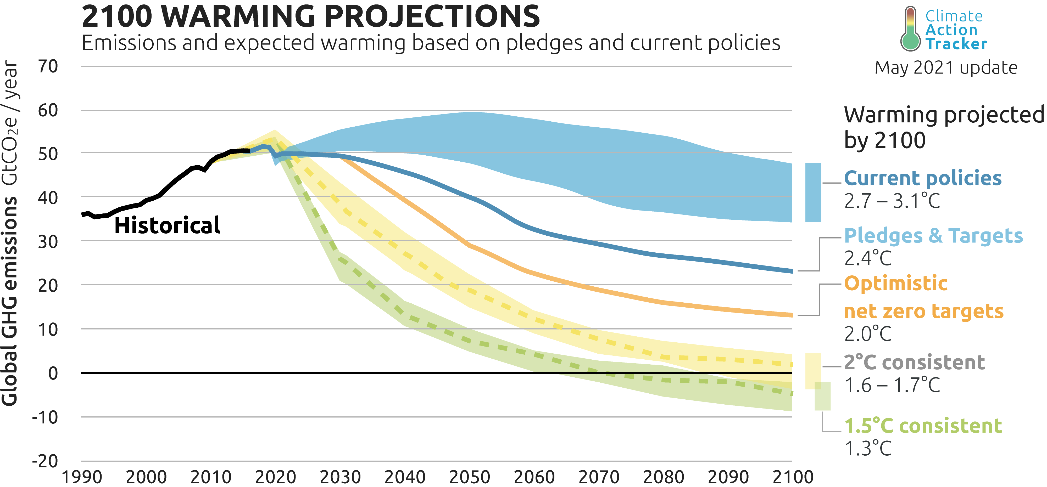
Climate projections
Notes:
SPEAKER NOTES:
To limit the temperature increase to 1.5, or even 2 °C, global emissions of greenhouse gases need to decrease rapidly in the next 10 years. Projections based on current policies predict a stabilization of emissions, but no reduction. This would lead to ~3 °C of warming by the end of the century.
CREDIT: © 2009-2021 by Climate Analytics and NewClimate Institute. All rights reserved. Any reproduction, in full or in part, must credit Climate Analytics and NewClimate Institute and must include a copyright notice and must not be used for commercial purposes
SOURCES:
Figure from Climate Action Tracker: https://climateactiontracker.org/global/temperatures/

Slide 7
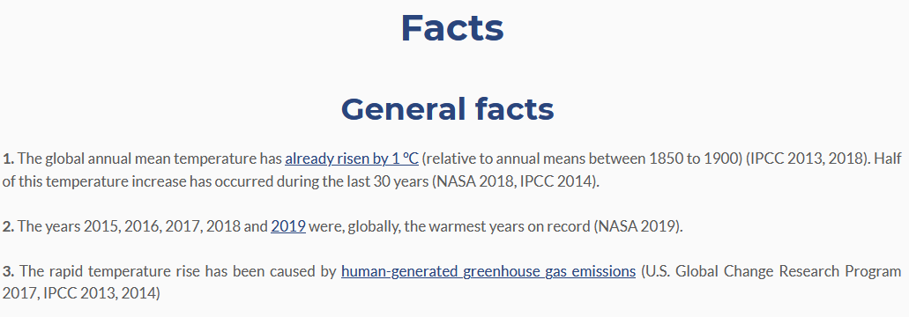
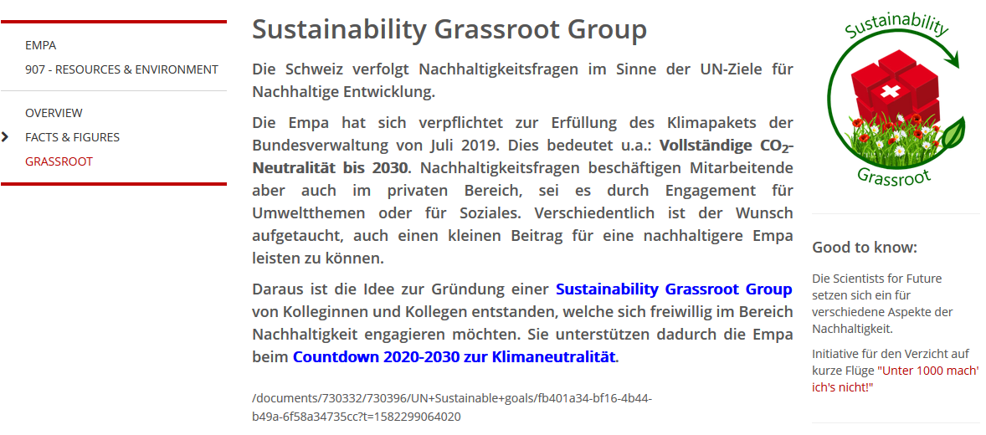
What you can do:
Get smart!
scientists4future.org
Personal goals
Get engaged!
Raise awareness – spread the word!
2minutes4future.org
Notes:
SPEAKER NOTES:
Achieving the CO₂ emission reduction necessary to stay within 1.5, or even 2 °C will require a rapid transformation affecting technological innovation and the global socio-economic system. The political actions that are needed to reduce CO₂ emissions can only be implemented if there will be a strong push from the population.
We all have the interest and the responsibility to contribute to this transformation:
Get informed, about climate change and its drivers. A good place to start is www.scientists4future.org
Raise awareness, talk about it with your family, friends, and colleague. Join the 2minutes4future campaign and insert a few slides in all your scientific presentations (conferences, lectures, lab meeting etc..). Convince you colleagues to do the same!
Awareness is not enough, set personal goals to reduce your carbon footprint
Ultimately political change is needed, become active in your community, support movements and political parties that are working for progress.
CREDIT: © Jan Overbeck and Fabrizio Menardo, CC-BY-SA 4.0

Slide 8
Backup / additional slides

Slide 9
The global temperature is rising fast
Notes:
SPEAKER NOTES:
Early Holocene was characterized by increasing temperature, which stabilized for about 5,000 years (Holocene climate optimum). After that a cooling trend prevailed, and culminated around 200 years ago in the little ice age, which was the coldest period of the Holocene.
In the last 100 years the average world temperature increased of about 1 °C, the temperature increase accelerated in the last 30 years (0.7 °C increase). Global temperatures are now higher than the average during the Holocene climate optimum.
CREDIT: © Fabrizio Menardo, CC-BY-SA 4.0
SOURCES:
Data from 1850 onward was obtained from HadCRUT4 (https://www.metoffice.gov.uk/hadobs/hadcrut4/). HadCRUT4 is a gridded dataset of global historical surface temperature anomalies relative to a 1961-1990 reference period. Data are available for each month since January 1850, on a 5 degree grid.
Citation: Morice, C. P., Kennedy, J. J., Rayner, N. A., and Jones, P. D. (2012), Quantifying uncertainties in global and regional temperature change using an ensemble of observational estimates: The HadCRUT4 data set, J. Geophys. Res., 117, D08101, doi:10.1029/2011JD017187.
Download global yearly data: https://www.metoffice.gov.uk/hadobs/hadcrut4/data/current/time_series/HadCRUT.4.6.0.0.annual_ns_avg.txt.
File format: https://www.metoffice.gov.uk/hadobs/hadcrut4/data/current/series_format.html.
Long term data (for the last ~11,300 years) was obtained from Marcott et al. 2013. These estimates are based on 73 globally distributed paleoclimate archives and temperature proxies, with sampling resolutions ranging from 20 to 500 years, and a median resolution of 120 years.
An important limitation of this data is that it does not fully resolve variability at periods shorter than 2000 years, with essentially no variability preserved at periods shorter than 300 years, ~50% preserved at 1000-year periods, and nearly all of the variability preserved for periods longer than 2000 years. The plot is based on the global 5x5 grid, and the shaded are represent 1σ uncertainty.
Citation: A Reconstruction of Regional and Global Temperature for the Past 11,300 Years Shaun A. Marcott et al. Science 339 , 1198 (2013); DOI: 10.1126/science.1228026.
Download data from supplementary table S1: https://science.sciencemag.org/highwire/filestream/594506/field_highwire_adjunct_files/1/Marcott.SM.database.S1.xlsx.
Additional information, data and code to generate this plot is available at https://github.com/fmenardo/2minutes4future.

Slide 10
Direct evidence of global warming
McCarthy-Glacier (Alaska)
Notes:
SPEAKER NOTES:
One of the most direct evidence of the warming of the last century is the rapid retreat of glacier occurring world wide.
CREDITS: © Arrangement G. Hagedorn, CC0, Both images Public Domain (via Commons)
SOURCES: https://commons.wikimedia.org/wiki/File:McCarty_Glacier.jpg, Image cropped and re-arranged.

Slide 11
Sea level is rising
Notes:
SPEAKER NOTES:
An important consequence of global warming is the rise of sea level. Since 1900 sea level rose by more than 20 cm, with an acceleration in the last 30 years (97 mm between 1993 and 2020). Since satellite measurements are available, on average the sea level rose by 3.3 mm per year. The main factors behind sea level rise are ice mass loss and thermic expansion.
CREDIT: © Fabrizio Menardo, CC-BY-SA 4.0
SOURCES:
From 1993 there is satellite data available from NASA on the sea level (https://climate.nasa.gov/vital-signs/sea-level/)
Citation: GSFC. 2020. Global Mean Sea Level Trend from Integrated Multi-Mission Ocean Altimeters TOPEX/Poseidon, Jason-1, OSTM/Jason-2, and Jason-3 Version 5.0 Ver. 5.0 PO.DAAC, CA, USA. Dataset accessed [2021-03-04] at http://dx.doi.org/10.5067/GMSLM-TJ150.
Download: https://podaac-tools.jpl.nasa.gov/drive/files/allData/merged_alt/L2/TP_J1_OSTM/global_mean_sea_level/GMSL_TPJAOS_5.0_199209_202010.txt (needs login)
Long term data were taken from Frederikse et al. (2020) and derive from tide gauge records
Citation: Frederikse, T., Landerer, F., Caron, L. et al. The causes of sea-level rise since 1900. Nature 584, 393–397 (2020). https://doi.org/10.1038/s41586-020-2591-3
Download: https://zenodo.org/record/3862995/files/global_basin_timeseries.xlsx?download=1
Additional information, data and code to generate this plot is available at https://github.com/fmenardo/2minutes4future.

Slide 12
Anthropogenic CO₂ emissions
Notes:
SPEAKER NOTES:
The fast increase of CO₂ concentration in the atmosphere was caused by anthropogenic emissions, due to combustion of fossil fuels, deforestation (not included in the plot) and other industrial processes.
Every years humanity release more CO₂ in the atmosphere, and there is an increasing trend. 2019 was the years with most CO₂ emissions on record, more than 15 times the emissions of 1900.
The data for 2020 is still provisional, Friedlingstein et al. 2020 predicted a decrease of ~2. 4 Gt compared to 2019, corresponding approximately to the level of 2011.
CREDIT: © Fabrizio Menardo, CC-BY-SA 4.0
SOURCES:
Data obtained from Friedlingstein et al. 2020. It includes emissions from fossil fuels combustion.
Citation: Friedlingstein et al. 2020. Earth Syst. Sci. Data, 12, 3269–3340, 2020 https://doi.org/10.5194/essd-12-3269-2020
Download: https://data.icos-cp.eu/licence_accept?ids=%5B%226QlPjfn_7uuJtAeuGGFXuPwz%22%5D
Additional information, data and code to generate this plot is available at https://github.com/fmenardo/2minutes4future.

Slide 13
Carbon cycle
Friedlingstein et al. 2020
Notes:
SPEAKER NOTES:
Over the last 10 years about 55% of anthropogenic CO₂ emissions have been absorbed by the ocean or by the earth biosphere, the remaining ~45% accumulated in the atmosphere.
CREDIT: © Friedlingstein et al. 2020, CC-BY-SA 4.0
SOURCES:
Schematic representation of the overall perturbation of the global carbon cycle caused by anthropogenic activities, averaged globally for the decade 2010–2019.
Figure 2 from Friedlingstein et al. 2020.
Citation: Friedlingstein et al. 2020. Earth Syst. Sci. Data, 12, 3269–3340, 2020 https://doi.org/10.5194/essd-12-3269-2020

Slide 14
Greenhouse effect
Wild et al. 2015
Notes:
SPEAKER NOTES:
Higher CO₂ (and other greenhouse gases) concentration in the atmosphere increases the greenhouse effect.
CREDIT: © Wild et al. 2014, CC-BY
SOURCES:
Figure 1 from Wild et al. 2015
Schematic diagram of the global (land and ocean) annual mean energy balance of the Earth. Numbers indicate best estimates for the magnitudes of the globally averaged energy balance components together with their uncertainty ranges in parentheses, representing present day climate conditions at the beginning of the twenty-first century. The surface thermal upward flux contains both the surface thermal emission and a small contribution from the reflected part of the downward thermal radiation. Units Wm².
Citation: Wild, M., Folini, D., Hakuba, M.Z. et al. The energy balance over land and oceans: an assessment based on direct observations and CMIP5 climate models. Clim Dyn 44, 3393–3429 (2015). https://doi.org/10.1007/s00382-014-2430-z.

Slide 15
Total solar irradiance
Notes:
SPEAKER NOTES:
Since 1979 there are measurements of the intensity of solar radiation. While total solar irradiance is highly variable on short time scales (days), it is evident that solar activity follows cycles of 11 years. These cycles were already discovered through the observation of sunspots. Changes in solar activity can influence earth’s climate significantly. However, in the last 40 years, there is no evidence for an increase of the solar energy received by earth, not on the scale necessary to explain the current warming.
CREDIT: © Fabrizio Menardo, CC-BY-SA 4.0
SOURCES:
This series is composed by measurements from several instruments in earth’s orbit, which are modeled with a neural network.
Citation: Mauceri, S., Coddington, O., Lyles, D. et al. Neural Network for Solar Irradiance Modeling (NN-SIM). Sol Phys 294, 160 (2019). https://doi.org/10.1007/s11207-019-1555-y
Additional information, data and code to generate this plot is available at https://github.com/fmenardo/2minutes4future.

