Slide 1
2 Minutes for Future

Slide 2
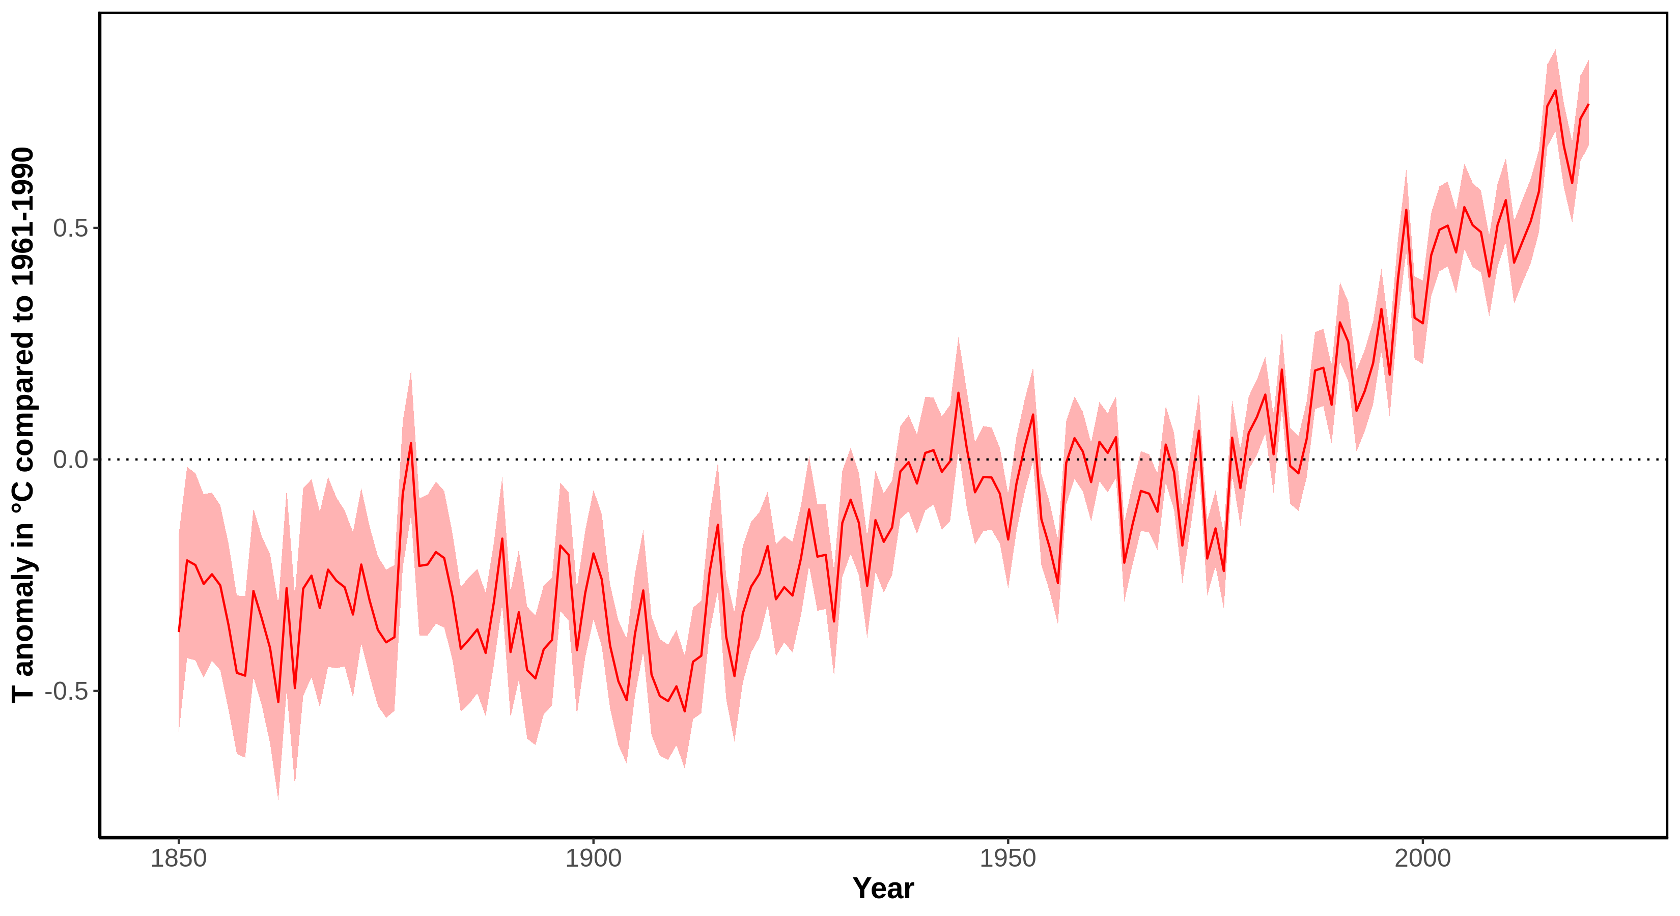
The global temperature is rising
Notes:
Message:
In the last 100 years the average world temperature increased of about 1 °C, the temperature increase accelerated in the last 30 years (0.7 °C increase compared to average 1961-1990).
Data:
Data from 1850 onward was obtained from HadCRUT4 (https://www.metoffice.gov.uk/hadobs/hadcrut4/). HadCRUT4 is a gridded dataset of global historical surface temperature anomalies relative to a 1961-1990 reference period. Data are available for each month since January 1850, on a 5 degree grid.
Citation: Morice, C. P., Kennedy, J. J., Rayner, N. A., and Jones, P. D. (2012), Quantifying uncertainties in global and regional temperature change using an ensemble of observational estimates: The HadCRUT4 data set, J. Geophys. Res., 117, D08101, doi:10.1029/2011JD017187.
Download global yearly data: https://www.metoffice.gov.uk/hadobs/hadcrut4/data/current/time_series/HadCRUT.4.6.0.0.annual_ns_avg.txt.
File format: https://www.metoffice.gov.uk/hadobs/hadcrut4/data/current/series_format.html.
Additional information, data and code to generate this plot is available at https://github.com/fmenardo/2minutes4future.

Slide 3
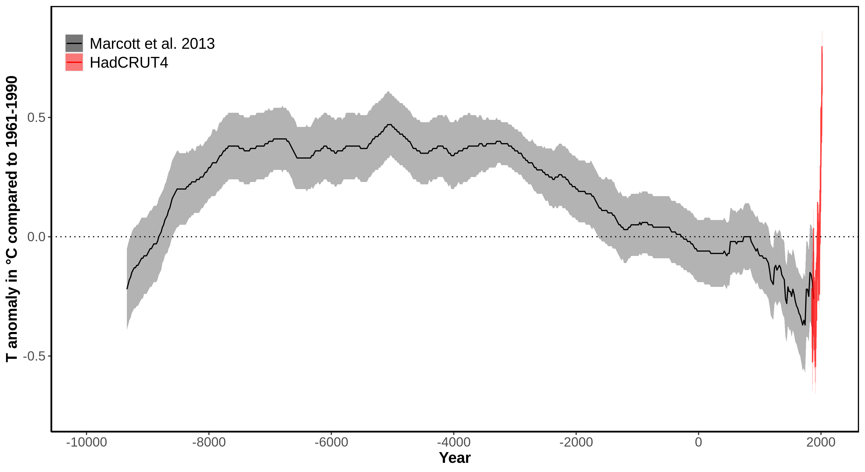
The global temperature is rising fast
Notes:
Message:
Early Holocene was characterized by increasing temperature, which stabilized for about 5,000 years (Holocene climate optimum). After that a cooling trend prevailed, and culminated around 200 years ago in the little ice age, which was the coldest period of the Holocene.
In the last 100 years the average world temperature increased of about 1 °C, the temperature increase accelerated in the last 30 years (0.7 °C increase). Global temperatures are now higher than the average during the Holocene climate optimum.
Data:
Data from 1850 onward was obtained from HadCRUT4 (https://www.metoffice.gov.uk/hadobs/hadcrut4/). HadCRUT4 is a gridded dataset of global historical surface temperature anomalies relative to a 1961-1990 reference period. Data are available for each month since January 1850, on a 5 degree grid.
Citation: Morice, C. P., Kennedy, J. J., Rayner, N. A., and Jones, P. D. (2012), Quantifying uncertainties in global and regional temperature change using an ensemble of observational estimates: The HadCRUT4 data set, J. Geophys. Res., 117, D08101, doi:10.1029/2011JD017187.
Download global yearly data: https://www.metoffice.gov.uk/hadobs/hadcrut4/data/current/time_series/HadCRUT.4.6.0.0.annual_ns_avg.txt.
File format: https://www.metoffice.gov.uk/hadobs/hadcrut4/data/current/series_format.html.
Long term data (for the last ~11,300 years) was obtained from Marcott et al. 2013. These estimates are based on 73 globally distributed paleoclimate archives and temperature proxies, with sampling resolutions ranging from 20 to 500 years, and a median resolution of 120 years.
An important limitation of this data is that it does not fully resolve variability at periods shorter than 2000 years, with essentially no variability preserved at periods shorter than 300 years, ~50% preserved at 1000-year periods, and nearly all of the variability preserved for periods longer than 2000 years. The plot is based on the global 5x5 grid, and the shaded are represent 1σ uncertainty.
Citation: A Reconstruction of Regional and Global Temperature for the Past 11,300 Years Shaun A. Marcott et al. Science 339 , 1198 (2013); DOI: 10.1126/science.1228026.
Download data from supplementary table S1: https://science.sciencemag.org/highwire/filestream/594506/field_highwire_adjunct_files/1/Marcott.SM.database.S1.xlsx.
Additional information, data and code to generate this plot is available at https://github.com/fmenardo/2minutes4future.

Slide 4
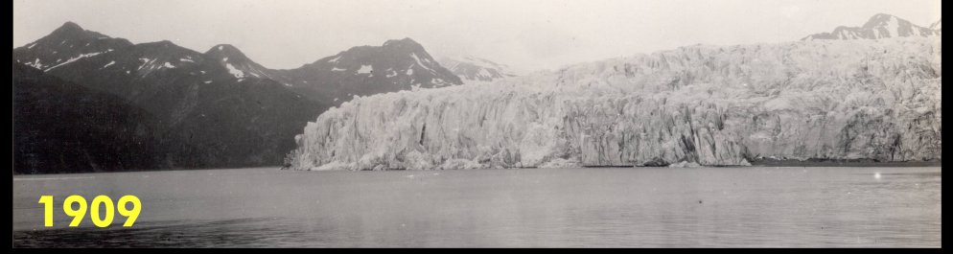
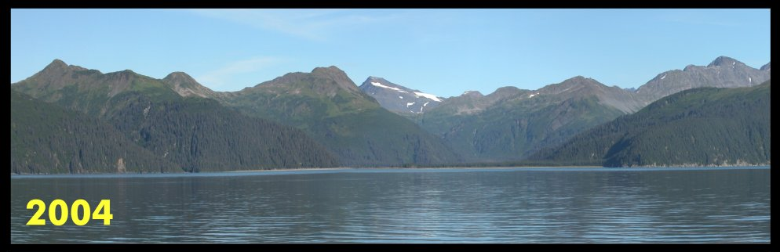
Direct evidence of global warming
McCarthy-Glacier (Alaska)
Notes:
Message:
One of the most direct evidence of the warming of the last century is the rapid retreat of glacier occurring world wide.
CREDITS: © Arrangement G. Hagedorn, CC0, Both images Public Domain (via Commons)
SOURCES: https://commons.wikimedia.org/wiki/File:McCarty_Glacier.jpg, Image cropped and re-arranged.

Slide 5
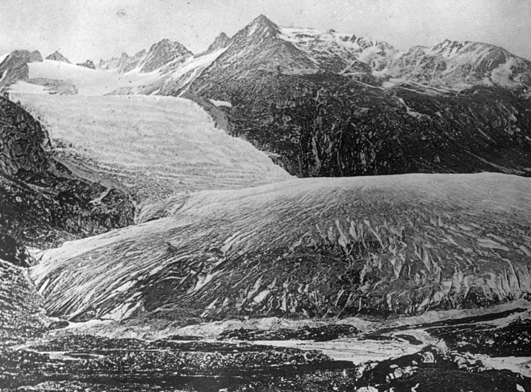
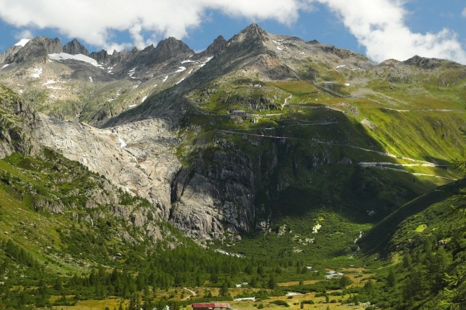
Direct evidence of global warming
Rhone glacier
(seen from Gletsch Switzerland)
in 1849 and in 2019
Notes:
Message:
One of the most direct evidence of the warming of the last century is the rapid retreat of glacier occurring world wide.
Source:
https://www.indiatoday.in/science/photo/climate-change-swiss-glaciers-switzerland-melt-photos-1622801-2019-11-26
Photo: REUTERS

Slide 6
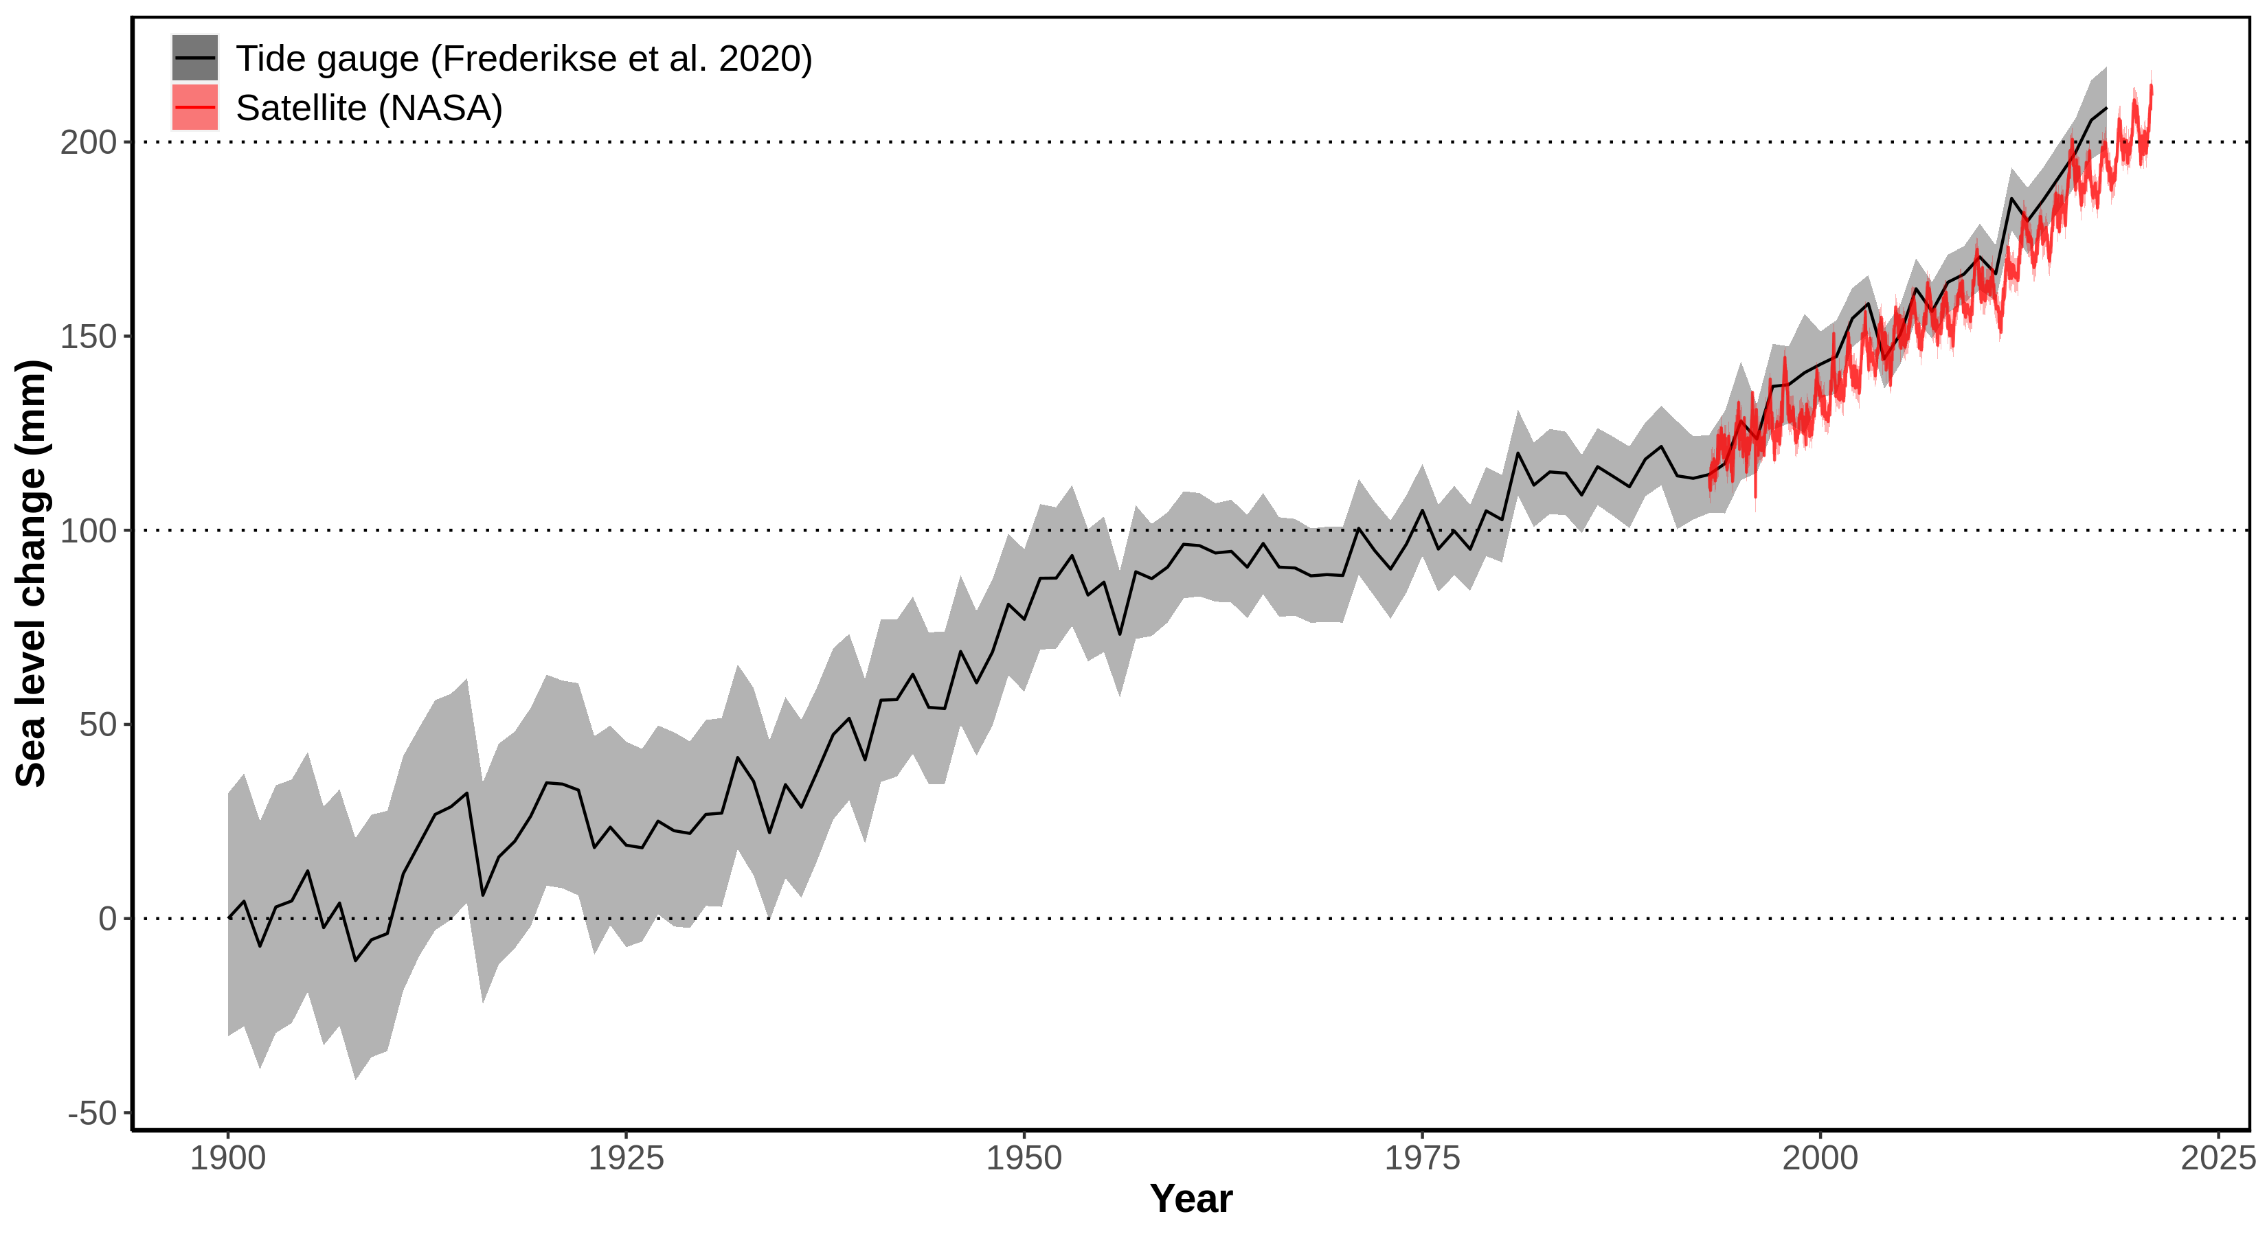
Sea level is rising
Notes:
Message:
An important consequence of global warming is the rise of sea level. Since 1900 sea level rose by more than 20 cm, with an acceleration in the last 30 years (97 mm between 1993 and 2020). Since satellite measurements are available, on average the sea level rose by 3.3 mm per year. The main factors behind sea level rise are ice mass loss and thermic expansion.
Data:
From 1993 there is satellite data available from NASA on the sea level (https://climate.nasa.gov/vital-signs/sea-level/)
Citation: GSFC. 2020. Global Mean Sea Level Trend from Integrated Multi-Mission Ocean Altimeters TOPEX/Poseidon, Jason-1, OSTM/Jason-2, and Jason-3 Version 5.0 Ver. 5.0 PO.DAAC, CA, USA. Dataset accessed [2021-03-04] at http://dx.doi.org/10.5067/GMSLM-TJ150.
Download: https://podaac-tools.jpl.nasa.gov/drive/files/allData/merged_alt/L2/TP_J1_OSTM/global_mean_sea_level/GMSL_TPJAOS_5.0_199209_202010.txt (needs login)
Long term data were taken from Frederikse et al. (2020) and derive from tide gauge records
Citation: Frederikse, T., Landerer, F., Caron, L. et al. The causes of sea-level rise since 1900. Nature 584, 393–397 (2020). https://doi.org/10.1038/s41586-020-2591-3
Download: https://zenodo.org/record/3862995/files/global_basin_timeseries.xlsx?download=1
Additional information, data and code to generate this plot is available at https://github.com/fmenardo/2minutes4future.

Slide 7
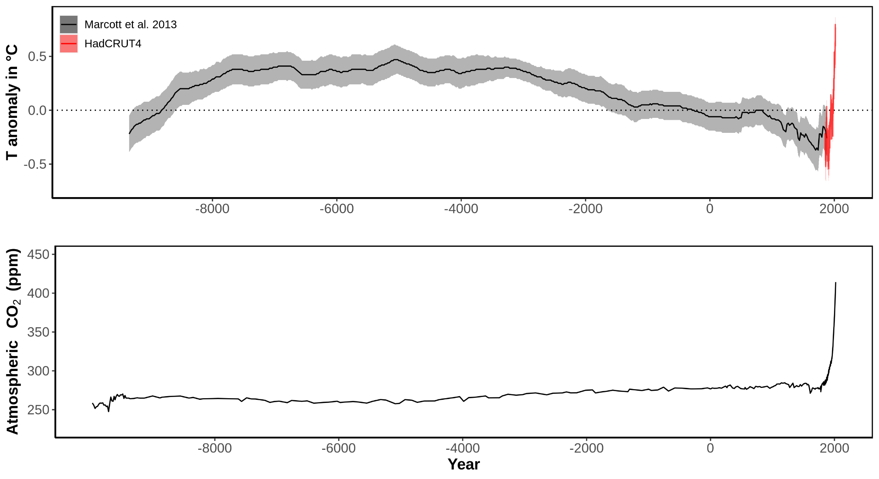
Global temperature and CO₂ concentration
Notes:
Message:
Early Holocene was characterized by increasing temperature, which stabilized for about 5,000 years (Holocene climate optimum). After that a cooling trend prevailed, and culminated around 200 years ago in the little ice age, which was the coldest period of the Holocene.
In the last 100 years the average world temperature increased of about 1 °C, the temperature increase accelerated in the last 30 years (0.7 °C increase). Global temperatures are now higher than the average during the Holocene climate optimum.
The fast increase in temperature in the last ~100 years was caused by an higher concentration of greenhouse gases in the atmosphere, especially CO₂. In the last 60 years the concentration of CO₂ increased from 317ppm (1960), to 339 ppm (1980), to 370 ppm (2000), to 414 ppm (2020).
Data:
Temperature:
Data from 1850 onward was obtained from HadCRUT4 (https://www.metoffice.gov.uk/hadobs/hadcrut4/). HadCRUT4 is a gridded dataset of global historical surface temperature anomalies relative to a 1961-1990 reference period. Data are available for each month since January 1850, on a 5 degree grid.
Citation: Morice, C. P., Kennedy, J. J., Rayner, N. A., and Jones, P. D. (2012), Quantifying uncertainties in global and regional temperature change using an ensemble of observational estimates: The HadCRUT4 data set, J. Geophys. Res., 117, D08101, doi:10.1029/2011JD017187.
Download global yearly data: https://www.metoffice.gov.uk/hadobs/hadcrut4/data/current/time_series/HadCRUT.4.6.0.0.annual_ns_avg.txt.
File format: https://www.metoffice.gov.uk/hadobs/hadcrut4/data/current/series_format.html.
Long term data (for the last ~11,300 years) was obtained from Marcott et al. 2013. These estimates are based on 73 globally distributed paleoclimate archives and temperature proxies, with sampling resolutions ranging from 20 to 500 years, and a median resolution of 120 years.
An important limitation of this data is that it does not fully resolve variability at periods shorter than 2000 years, with essentially no variability preserved at periods shorter than 300 years, ~50% preserved at 1000-year periods, and nearly all of the variability preserved for periods longer than 2000 years. The plot is based on the global 5x5 grid, and the shaded are represent 1σ uncertainty.
Citation: A Reconstruction of Regional and Global Temperature for the Past 11,300 Years Shaun A. Marcott et al. Science 339 , 1198 (2013); DOI: 10.1126/science.1228026.
Download data from supplementary table S1: https://science.sciencemag.org/highwire/filestream/594506/field_highwire_adjunct_files/1/Marcott.SM.database.S1.xlsx.
CO2:
Data from 1959 through 1979 have been obtained by C. David Keeling of the Scripps Institution of Oceanography (SIO) and were obtained from the Scripps website (scrippsco2.ucsd.edu). Data from 1980 onwards is sourced from NOAA's Mauna Loa monitoring station. These are direct measurements.
Download: https://www.esrl.noaa.gov/gmd/webdata/ccgg/trends/co2/co2_annmean_mlo.txt
Long-term data (~10,000 BC - 1958 AD) derives from ice cores – specifically the Dome C core – and has been made available from the NOAA here: https://www.ncdc.noaa.gov/paleo-search/study/17975. The data was compiled by Our world in data: some years had multiple measurements (taken at different points of the year). To normalize this to a single year, where several measurements were available, we took the average of these concentration values. Dome C data has been used until the year 1958.
Citation: Bereiter, B., Eggleston, S., Schmitt, J., Nehrbass‐Ahles, C., Stocker, T. F., Fischer, H., ... & Chappellaz, J. (2015). Revision of the EPICA Dome C CO2 record from 800 to 600 kyr before present. Geophysical Research Letters, 42(2), 542-549.
Download: https://ourworldindata.org/co2-and-other-greenhouse-gas-emissions/
Additional information, data and code to generate this plot is available at https://github.com/fmenardo/2minutes4future.

Slide 8
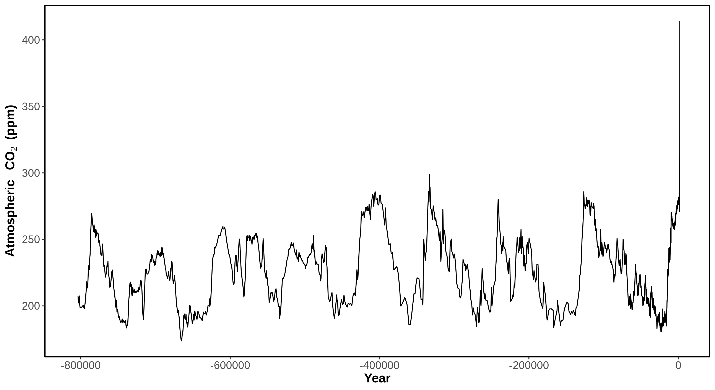
CO₂ concentration in the atmosphere
Notes:
Message:
For the last 800 thousands year, the atmospheric CO2 concentration oscillated between ~150 and 300 ppm. The periods with low CO2 concentration were ice ages, the last of which was concluded between ~115,000 and 12,000 years ago. The periods between ice ages, with higher CO2 concentration, are warmer interglacial periods. In the last 60 years the concentration of CO2 in the atmosphere increased drastically. 1960: 317 ppm; 1980: 339 ppm; 2000: 370 ppm; 2020: 414 ppm.
Data:
Data from 1959 through 1979 have been obtained by C. David Keeling of the Scripps Institution of Oceanography (SIO) and were obtained from the Scripps website (scrippsco2.ucsd.edu). Data from 1980 onwards is sourced from NOAA's Mauna Loa monitoring station. These are direct measurements.
Download: https://www.esrl.noaa.gov/gmd/webdata/ccgg/trends/co2/co2_annmean_mlo.txt
Long-term data (~800,000 BC - 1958 AD) derives from ice cores – specifically the Dome C core – and has been made available from the NOAA here: https://www.ncdc.noaa.gov/paleo-search/study/17975. The data was compiled by Our world in data: some years had multiple measurements (taken at different points of the year). To normalize this to a single year, where several measurements were available, we took the average of these concentration values. Dome C data has been used until the year 1958.
Citation: Bereiter, B., Eggleston, S., Schmitt, J., Nehrbass‐Ahles, C., Stocker, T. F., Fischer, H., ... & Chappellaz, J. (2015). Revision of the EPICA Dome C CO2 record from 800 to 600 kyr before present. Geophysical Research Letters, 42(2), 542-549.
Download: https://ourworldindata.org/co2-and-other-greenhouse-gas-emissions/
Additional information, data and code to generate this plot is available at https://github.com/fmenardo/2minutes4future.

Slide 9
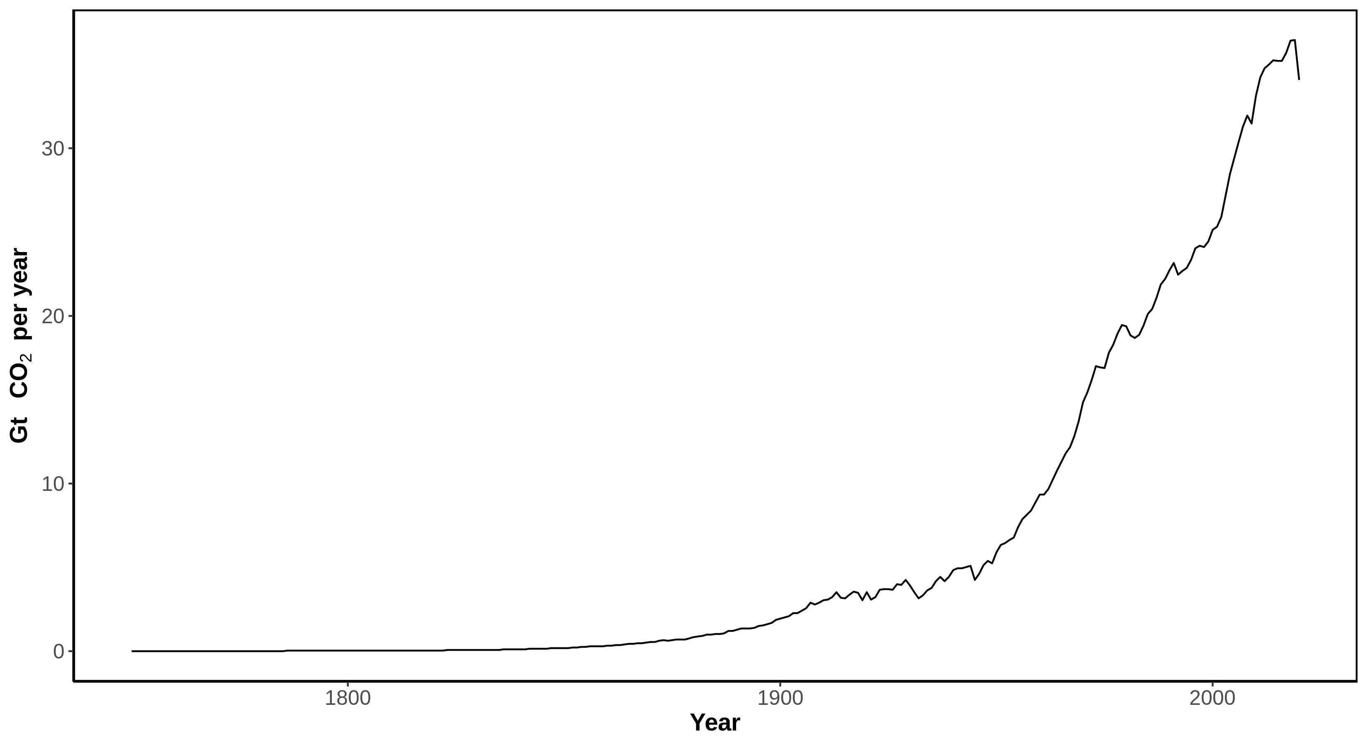
Anthropogenic CO₂ emissions
Notes:
Message:
The fast increase of CO₂ concentration in the atmosphere was caused by anthropogenic emissions, due to combustion of fossil fuels, deforestation (not included in the plot) and other industrial processes.
Every years humanity release more CO₂ in the atmosphere, and there is an increasing trend. 2019 was the years with most CO₂ emissions on record, more than 15 times the emissions of 1900.
The data for 2020 is still provisional, Friedlingstein et al. 2020 predicted a decrease of ~2. 4 Gt compared to 2019, corresponding approximately to the level of 2011.
Data:
Data obtained from Friedlingstein et al. 2020. It includes emissions from fossil fuels combustion.
Citation: Friedlingstein et al. 2020. Earth Syst. Sci. Data, 12, 3269–3340, 2020 https://doi.org/10.5194/essd-12-3269-2020
Download: https://data.icos-cp.eu/licence_accept?ids=%5B%226QlPjfn_7uuJtAeuGGFXuPwz%22%5D
Additional information, data and code to generate this plot is available at https://github.com/fmenardo/2minutes4future.

Slide 10
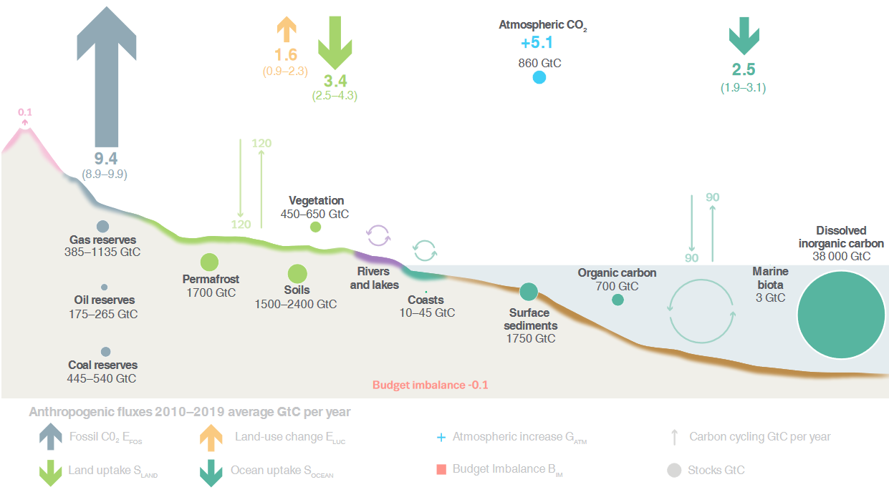
Carbon cycle
Friedlingstein et al. 2020
Notes:
Message:
Over the last 10 years about 55% of anthropogenic CO₂ emissions have been absorbed by the ocean or by the earth biosphere, the remaining ~45% accumulated in the atmosphere.
Data:
Schematic representation of the overall perturbation of the global carbon cycle caused by anthropogenic activities, averaged globally for the decade 2010–2019.
Figure 2 from Friedlingstein et al. 2020.
Citation: Friedlingstein et al. 2020. Earth Syst. Sci. Data, 12, 3269–3340, 2020 https://doi.org/10.5194/essd-12-3269-2020

Slide 11
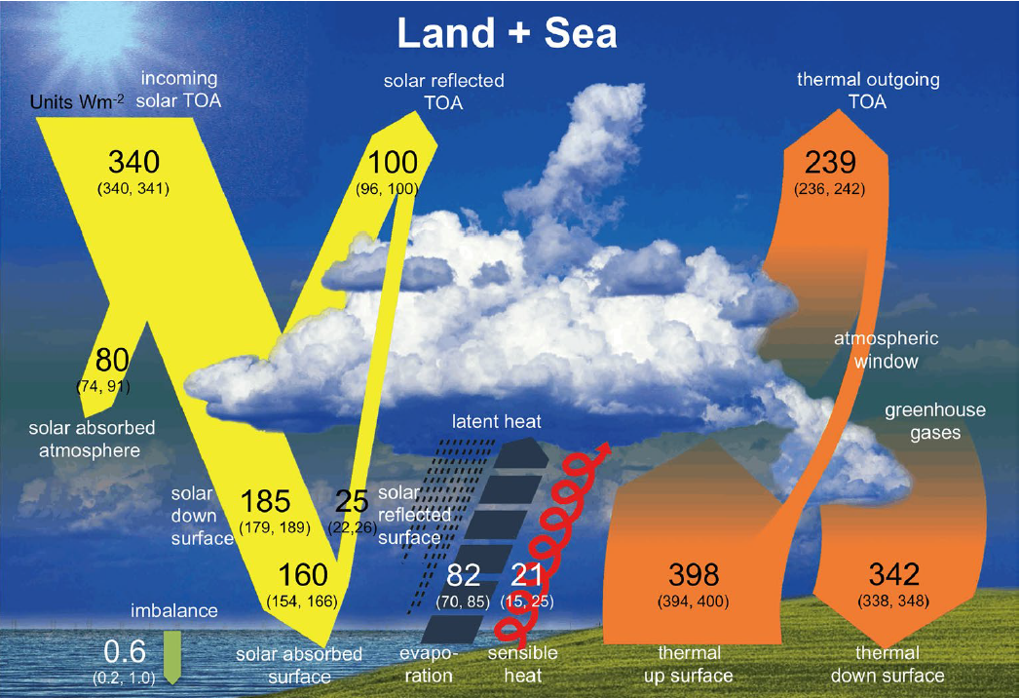
Greenhouse effect
Wild et al. 2015
Notes:
Message:
Higher CO₂ (and other greenhouse gases) concentration in the atmosphere increases the greenhouse effect.
Data:
Figure 1 from Wild et al. 2015
Schematic diagram of the global (land and ocean) annual mean energy balance of the Earth. Numbers indicate best estimates for the magnitudes of the globally averaged energy balance components together with their uncertainty ranges in parentheses, representing present day climate conditions at the beginning of the twenty-first century. The surface thermal upward flux contains both the surface thermal emission and a small contribution from the reflected part of the downward thermal radiation. Units Wm².
Citation: Wild, M., Folini, D., Hakuba, M.Z. et al. The energy balance over land and oceans: an assessment based on direct observations and CMIP5 climate models. Clim Dyn 44, 3393–3429 (2015). https://doi.org/10.1007/s00382-014-2430-z.

Slide 12
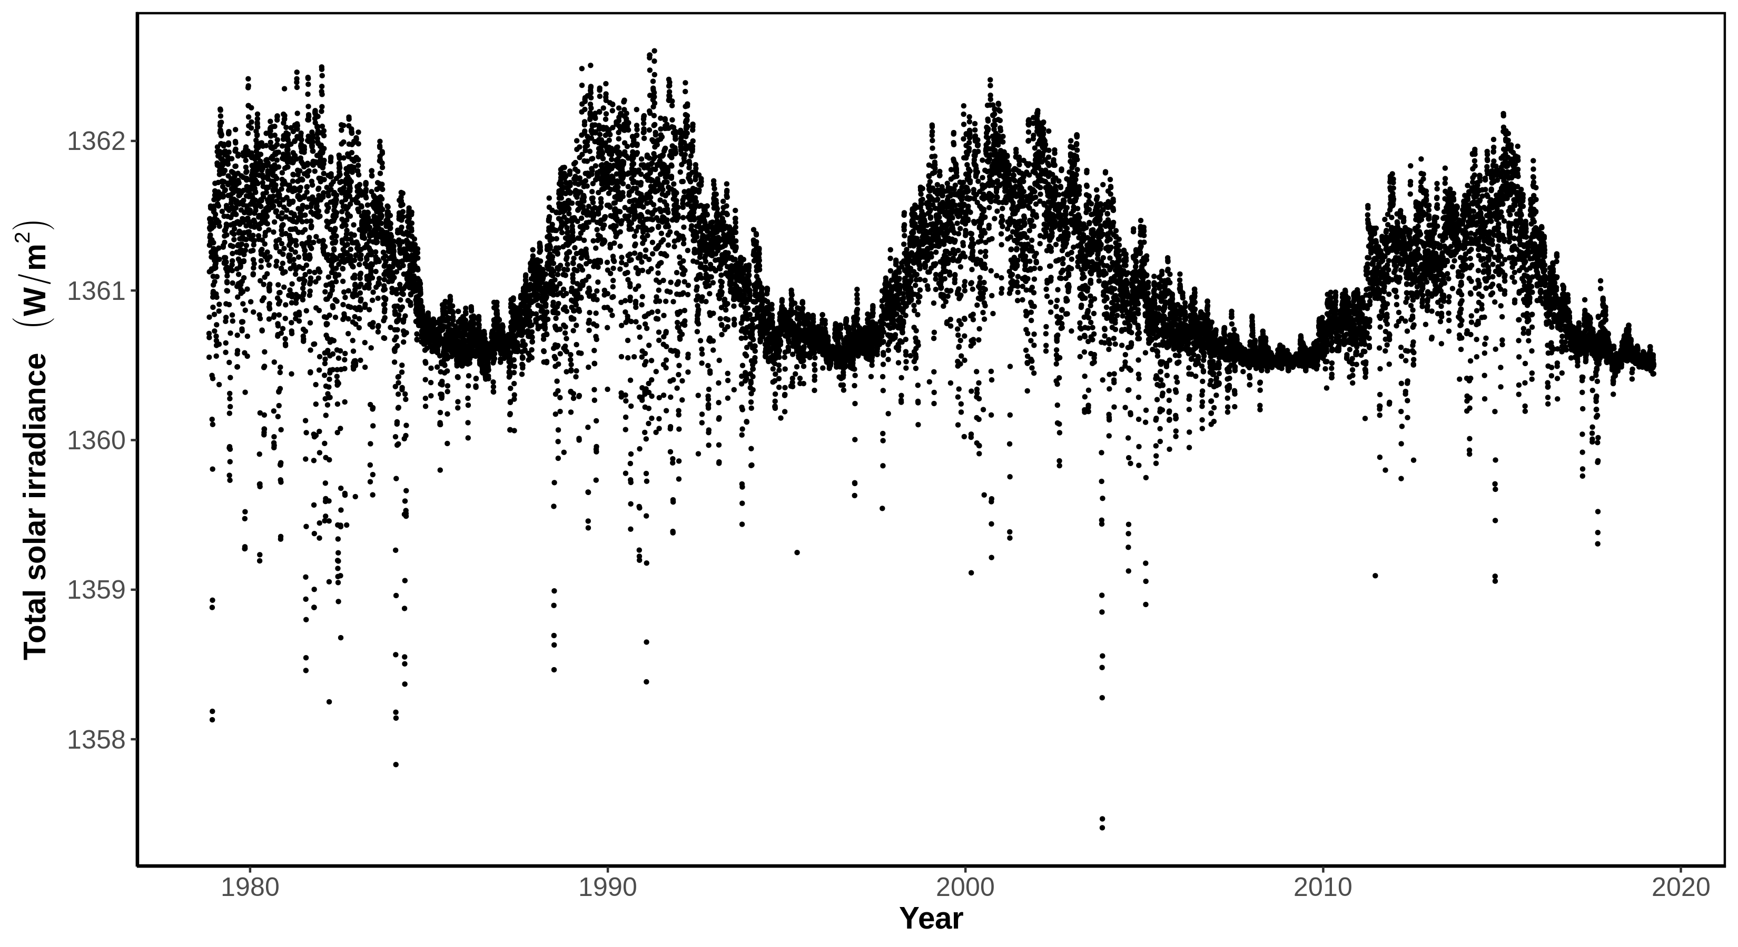
Total solar irradiance
Notes:
Message:
Since 1979 there are measurements of the intensity of solar radiation. While total solar irradiance is highly variable on short time scales (days), it is evident that solar activity follows cycles of 11 years. These cycles were already discovered through the observation of sunspots. Changes in solar activity can influence earth’s climate significantly. However, in the last 40 years, there is no evidence for an increase of the solar energy received by earth, not on the scale necessary to explain the current warming.
Data:
This series is composed by measurements from several instruments in earth’s orbit, which are modeled with a neural network.
Citation: Mauceri, S., Coddington, O., Lyles, D. et al. Neural Network for Solar Irradiance Modeling (NN-SIM). Sol Phys 294, 160 (2019). https://doi.org/10.1007/s11207-019-1555-y
Additional information, data and code to generate this plot is available at https://github.com/fmenardo/2minutes4future.

Slide 13
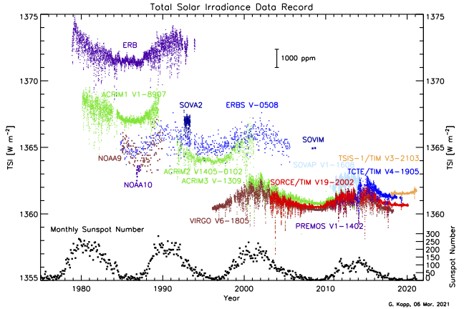
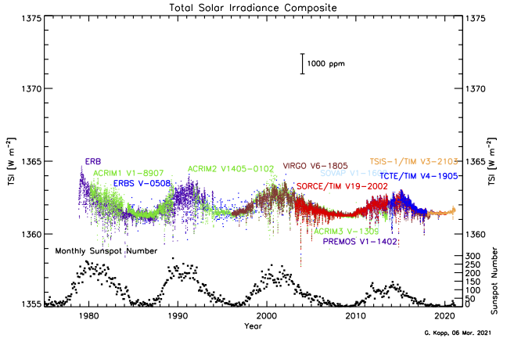
Total solar irradiance
Notes:
Message:
Since 1979 there are measurements of the intensity of solar radiation. While total solar irradiance is highly variable on short time scales (days) it is evident that solar activity follows cycles of 11 years. These cycles were already discovered through the obervation of sunspots. Changes in solar activity can influence earth’s climate significantly. However, in the last 40 years, there is no evidence for an increase of the solar energy received by earth, not on the scale necessary to explain the current warming.
Data:
These plots are taken from Greg Kopp (https://spot.colorado.edu/~koppg/TSI/). Greg is The method to calculate the composite was taken from (T. Dudok de Wit, G. Kopp, C. Fröhlich, and M. Schöll, Methodology to create a new Total Solar Irradiance record: Making a composite out of multiple data records, Geophys. Res. Letters, doi:10.1002/2016GL071866, 2017.)
Additional information is available at (https://spot.colorado.edu/~koppg/TSI/).

Slide 14
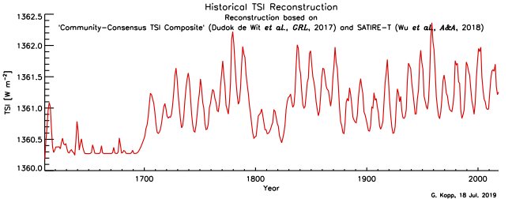
Total solar irradiance
Notes:
Message:
Thanks to the correlation between the observed total solar irradiance (TSI), and the number of sunspots, it is possible to reconstruct TSI for the last 400 years, based on historic sunspots observations. In the last 300 years there is no observable trend. The period of low activity in the 17th century is known as the Maunder minimum, and it likely contributed to the little ice age.
Data:
This plots is taken from Greg Kopp (https://spot.colorado.edu/~koppg/TSI/). “This historical TSI reconstruction is my own "unofficial" series using corrections that I think reflect the most realistic and up-to-date estimates of the solar variability over the last 400 years, such as the recent revisions to sunspot-number records. Working backward from the present, I start with the spacecraft-era instrument-based TSI values from the Community-Consensus TSI Composite, covering the years 1978 to the present. Prior to that I use the SATIRE-T historical TSI reconstruction model by Wu et al., A&A, 2018 after scaling the model a nearly-negligible amount to match the present-day composite. I replaced the Wu et al. model's as-provided (but clearly spurious) values affecting the 1642-1648 time range using values scaled from the SATIRE S&T model for years prior to 1650. “
Additional information is available at (https://spot.colorado.edu/~koppg/TSI/).

Slide 15
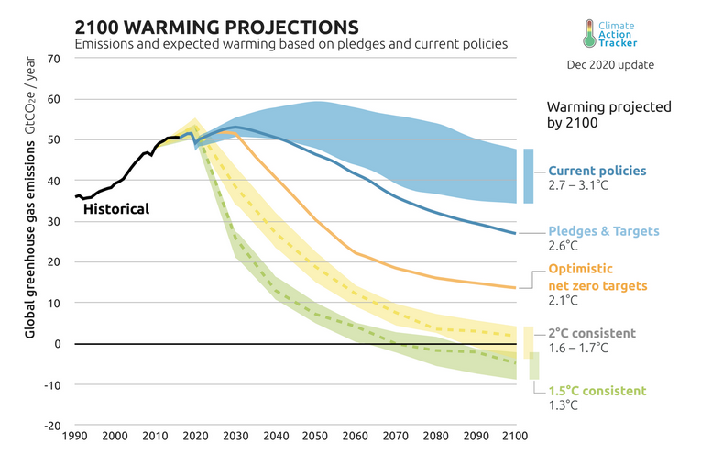
Climate projections
Notes:
Message:
To limit the temperature increase to 1.5, or even 2 °C, global emissions of greenhouse gases need to decrease rapidly in the next 10 years. Projections based on current policies predict a stabilization of emissions, but no reduction. This would lead to ~3 °C of warming by the end of the century.
Data:
Figure from Climate Action Tracker: https://climateactiontracker.org/global/temperatures/

Slide 16
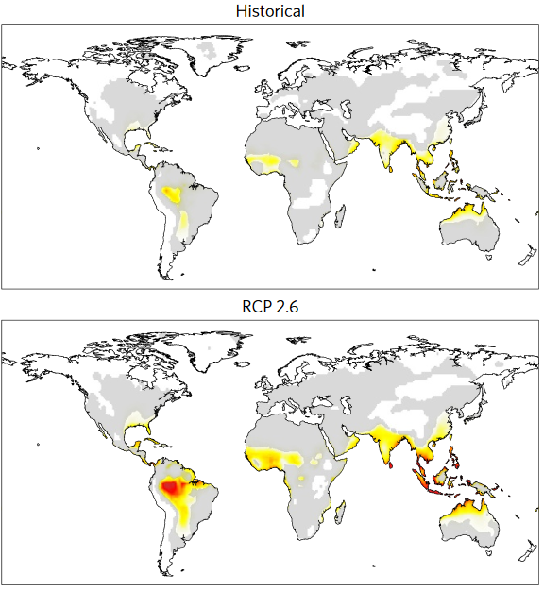
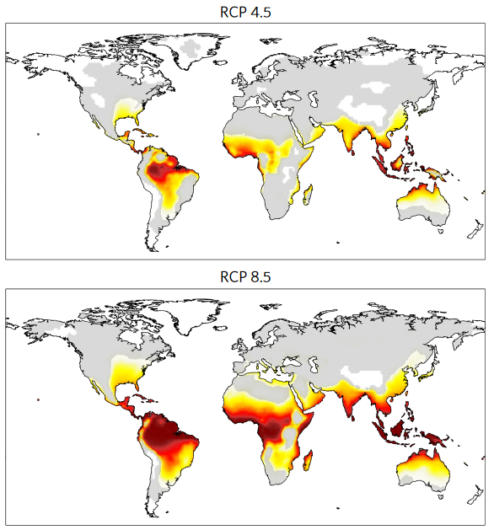
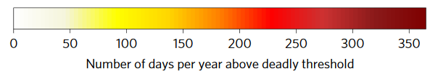
Days of deadly heat now and in 2100
Mora et al. 2017
Notes:
Message:
A large part of the planet will experience permanent deadly heat conditions.
One of the most direct consequences of global warming is the increase in the number days per year exceeding the threshold of temperature and humidity beyond which climatic conditions become deadly. This threshold was inferred empirically from 783 cases in which a an excess mortality was associated with a heat event (See Mora et al. 2017 for details). The Historical data refer to the period between 1995 and 2005, while the projections refer to the period 2090-2100.
RCP2.6 is a mitigation scenario compatible with a temperature increase below 2°C (compared to pre-industrial time)
RCP4.5 is an intermediate mitigation scenario
RCP8.5 is considered as a business as usual scenario
Emissions until 2020 are in line with the RCP8.5 scenario (Schwalm, C. R., Glendon, S., & Duffy, P. B. (2020). RCP8. 5 tracks cumulative CO2 emissions. Proceedings of the National Academy of Sciences, 117(33), 19656-19657. https://doi.org/10.1073/pnas.2007117117
Prediction for the end of the century are somwhere in between RCP4.5 and RCP8.5 (Schwalm et al. 2020, Climate Action Tracker: https://climateactiontracker.org/global/temperatures/)
Data:
Figure 3 Mora et al. 2017. Geographical distribution of deadly climatic conditions under different emission scenarios. Number of days per year exceeding the threshold of temperature and humidity beyond which climatic conditions become deadly averaged between 1995 and 2005 (Historical), and between 2090 and 2100 under RCP 2.6, RCP 4.5 and RCP 8.5. Results are based on multi model medians. Grey areas indicate locations with high uncertainty (that is, the multi model standard deviation was larger than the projected mean; coefficient of variance>1).The expected lower number of deadly days at higher latitudes may help explain the large variability among Earth System Models in the projected number of deadly days at higher latitudes. The uncertainty presented in this figure should be interpreted with that caution in mind.
Citation: Mora, C., Dousset, B., Caldwell, I. et al. Global risk of deadly heat. Nature Clim Change 7, 501–506 (2017). https://doi.org/10.1038/nclimate3322

Slide 17
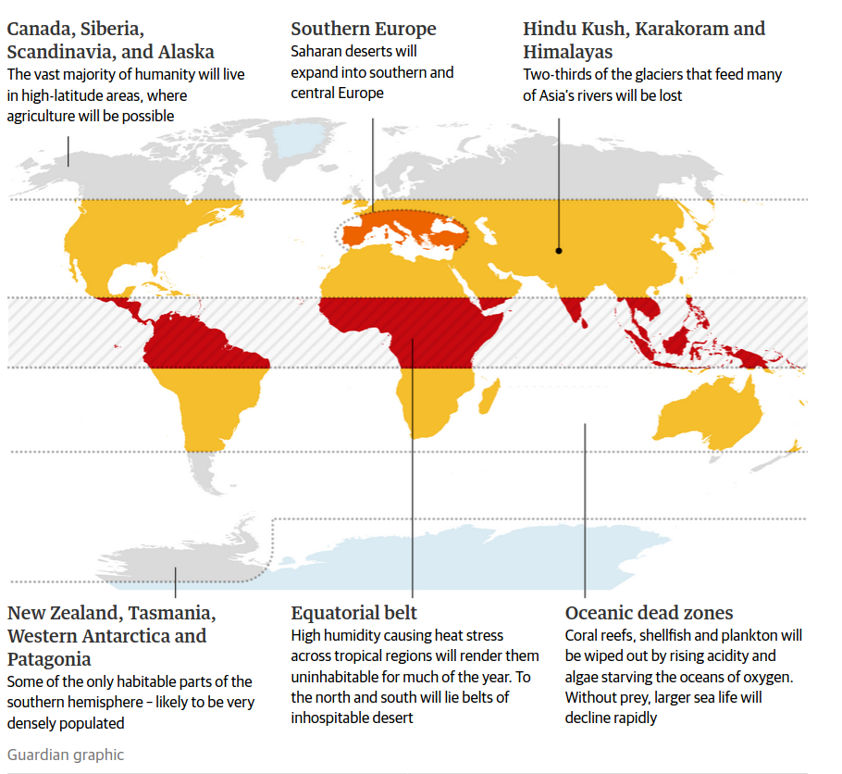
Possible consequences in +4°C world
Notes:
Message:
A +4°C world wil drasticall different from what we know. Two important consequences not reported in the map are sea level rise, and increase in extreme weather events.
Source: https://www.theguardian.com/environment/2019/may/18/climate-crisis-heat-is-on-global-heating-four-degrees-2100-change-way-we-live

Slide 18
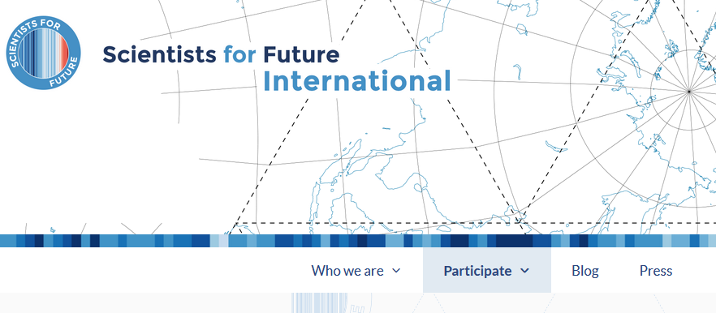

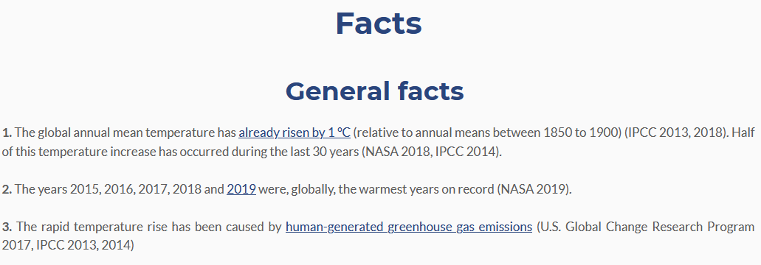

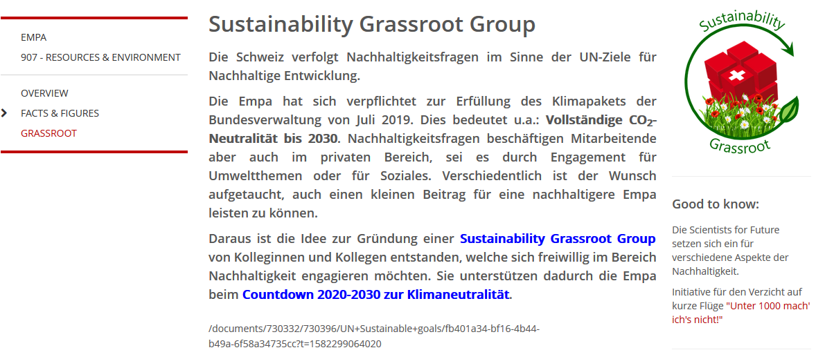
What you can do:
Get smart!
scientists4future.org
Get engaged!
Personal goal
Join a movement
Raise awareness – spread the word!
2minutes4future.org
Notes:
Message:
Achieving the CO₂ emission reduction necessary to stay within 1.5, or even 2 °C will require a rapid transformation affecting technological innovation and the global socio-economic system. The political actions that are needed to reduce CO₂ emissions can only be implemented if there will be a strong push from the population.
We all have the interest and the responsibility to contribute to this transformation:
Get informed, about climate change and its drivers. A good place to start is www.scientists4future.org
Raise awareness, talk about it with your family, friends, and colleague. Join the 2minutes4future campaign and insert a few slides in all your scientific presentations (conferences, lectures, lab meeting etc..). Convince you colleagues to do the same!
Awareness is not enough, set personal goals to reduce your carbon footprint
Ultimately political change is needed, become active in your community

