Slide 1
On personal note…
2 Minutes for Future

Slide 2
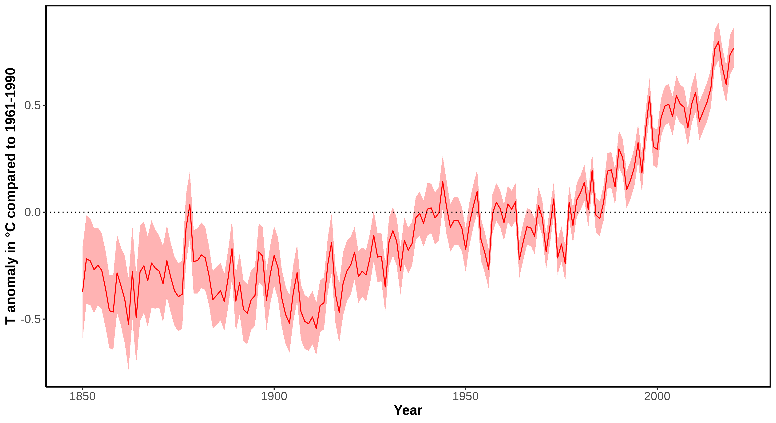
The global temperature is rising
Notes:
Message:
In the last 100 years the average world temperature increased of about 1 °C, the temperature increase accelerated in the last 30 years (0.7 °C increase compared to average 1961-1990).
Data:
Data from 1850 onward was obtained from HadCRUT4 (https://www.metoffice.gov.uk/hadobs/hadcrut4/). HadCRUT4 is a gridded dataset of global historical surface temperature anomalies relative to a 1961-1990 reference period. Data are available for each month since January 1850, on a 5 degree grid.
Citation: Morice, C. P., Kennedy, J. J., Rayner, N. A., and Jones, P. D. (2012), Quantifying uncertainties in global and regional temperature change using an ensemble of observational estimates: The HadCRUT4 data set, J. Geophys. Res., 117, D08101, doi:10.1029/2011JD017187.
Download global yearly data: https://www.metoffice.gov.uk/hadobs/hadcrut4/data/current/time_series/HadCRUT.4.6.0.0.annual_ns_avg.txt.
File format: https://www.metoffice.gov.uk/hadobs/hadcrut4/data/current/series_format.html.
Additional information, data and code to generate this plot is available at https://github.com/fmenardo/2minutes4future.

Slide 3
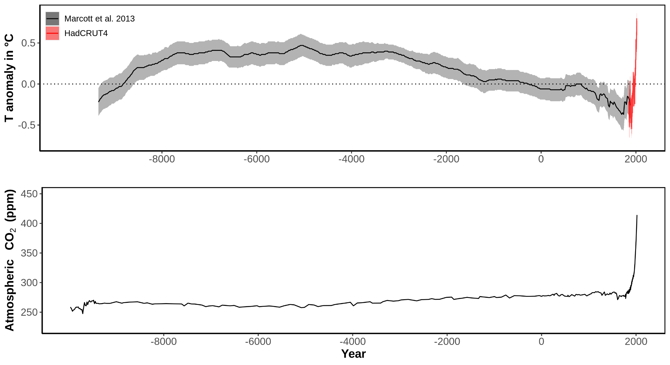
Global temperature and CO₂ concentration
Notes:
Message:
Early Holocene was characterized by increasing temperature, which stabilized for about 5,000 years (Holocene climate optimum). After that a cooling trend prevailed, and culminated around 200 years ago in the little ice age, which was the coldest period of the Holocene.
In the last 100 years the average world temperature increased of about 1 °C, the temperature increase accelerated in the last 30 years (0.7 °C increase). Global temperatures are now higher than the average during the Holocene climate optimum.
The fast increase in temperature in the last ~100 years was caused by an higher concentration of greenhouse gases in the atmosphere, especially CO₂. In the last 60 years the concentration of CO₂ increased from 317ppm (1960), to 339 ppm (1980), to 370 ppm (2000), to 414 ppm (2020).
Data:
Temperature:
Data from 1850 onward was obtained from HadCRUT4 (https://www.metoffice.gov.uk/hadobs/hadcrut4/). HadCRUT4 is a gridded dataset of global historical surface temperature anomalies relative to a 1961-1990 reference period. Data are available for each month since January 1850, on a 5 degree grid.
Citation: Morice, C. P., Kennedy, J. J., Rayner, N. A., and Jones, P. D. (2012), Quantifying uncertainties in global and regional temperature change using an ensemble of observational estimates: The HadCRUT4 data set, J. Geophys. Res., 117, D08101, doi:10.1029/2011JD017187.
Download global yearly data: https://www.metoffice.gov.uk/hadobs/hadcrut4/data/current/time_series/HadCRUT.4.6.0.0.annual_ns_avg.txt.
File format: https://www.metoffice.gov.uk/hadobs/hadcrut4/data/current/series_format.html.
Long term data (for the last ~11,300 years) was obtained from Marcott et al. 2013. These estimates are based on 73 globally distributed paleoclimate archives and temperature proxies, with sampling resolutions ranging from 20 to 500 years, and a median resolution of 120 years.
An important limitation of this data is that it does not fully resolve variability at periods shorter than 2000 years, with essentially no variability preserved at periods shorter than 300 years, ~50% preserved at 1000-year periods, and nearly all of the variability preserved for periods longer than 2000 years. The plot is based on the global 5x5 grid, and the shaded are represent 1σ uncertainty.
Citation: A Reconstruction of Regional and Global Temperature for the Past 11,300 Years Shaun A. Marcott et al. Science 339 , 1198 (2013); DOI: 10.1126/science.1228026.
Download data from supplementary table S1: https://science.sciencemag.org/highwire/filestream/594506/field_highwire_adjunct_files/1/Marcott.SM.database.S1.xlsx.
CO2:
Data from 1959 through 1979 have been obtained by C. David Keeling of the Scripps Institution of Oceanography (SIO) and were obtained from the Scripps website (scrippsco2.ucsd.edu). Data from 1980 onwards is sourced from NOAA's Mauna Loa monitoring station. These are direct measurements.
Download: https://www.esrl.noaa.gov/gmd/webdata/ccgg/trends/co2/co2_annmean_mlo.txt
Long-term data (~10,000 BC - 1958 AD) derives from ice cores – specifically the Dome C core – and has been made available from the NOAA here: https://www.ncdc.noaa.gov/paleo-search/study/17975. The data was compiled by Our world in data: some years had multiple measurements (taken at different points of the year). To normalize this to a single year, where several measurements were available, we took the average of these concentration values. Dome C data has been used until the year 1958.
Citation: Bereiter, B., Eggleston, S., Schmitt, J., Nehrbass‐Ahles, C., Stocker, T. F., Fischer, H., ... & Chappellaz, J. (2015). Revision of the EPICA Dome C CO2 record from 800 to 600 kyr before present. Geophysical Research Letters, 42(2), 542-549.
Download: https://ourworldindata.org/co2-and-other-greenhouse-gas-emissions/
Additional information, data and code to generate this plot is available at https://github.com/fmenardo/2minutes4future.

Slide 4
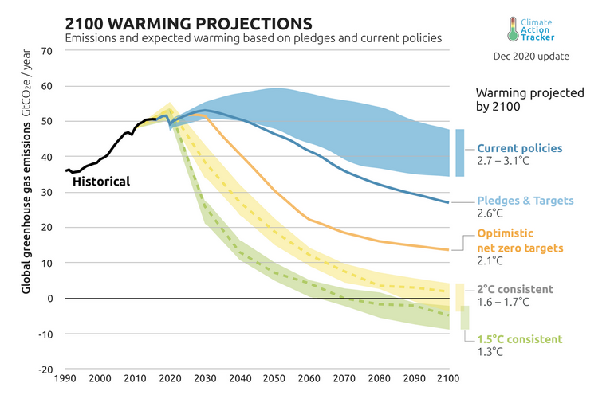
Climate projections
Notes:
Message:
To limit the temperature increase to 1.5, or even 2 °C, global emissions of greenhouse gases need to decrease rapidly in the next 10 years. Projections based on current policies predict a stabilization of emissions, but no reduction. This would lead to ~3 °C of warming by the end of the century.
Data:
Figure from Climate Action Tracker: https://climateactiontracker.org/global/temperatures/

Slide 5
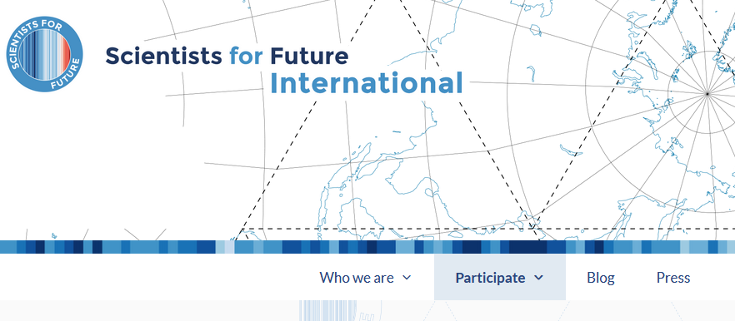
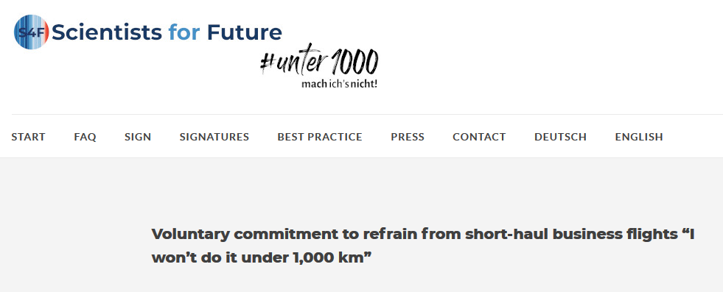
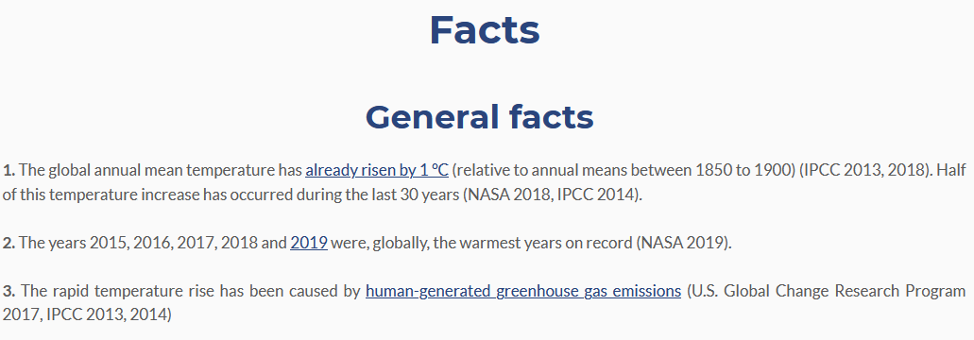

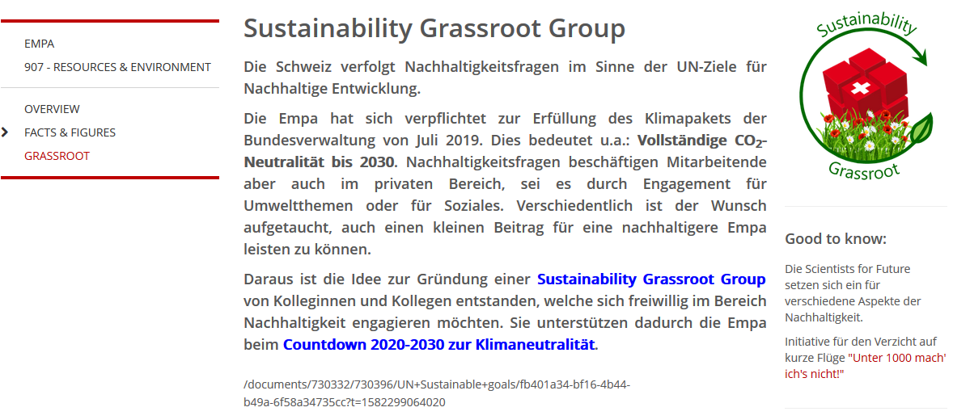
What you can do:
Get smart!
scientists4future.org
Get engaged!
Personal goal
Join a movement
Raise awareness – spread the word!
2minutes4future.org
Notes:
Message:
Achieving the CO₂ emission reduction necessary to stay within 1.5, or even 2 °C will require a rapid transformation affecting technological innovation and the global socio-economic system. The political actions that are needed to reduce CO₂ emissions can only be implemented if there will be a strong push from the population.
We all have the interest and the responsibility to contribute to this transformation:
Get informed, about climate change and its drivers. A good place to start is www.scientists4future.org
Raise awareness, talk about it with your family, friends, and colleague. Join the 2minutes4future campaign and insert a few slides in all your scientific presentations (conferences, lectures, lab meeting etc..). Convince you colleagues to do the same!
Awareness is not enough, set personal goals to reduce your carbon footprint
Ultimately political change is needed, become active in your community

