Slide 1
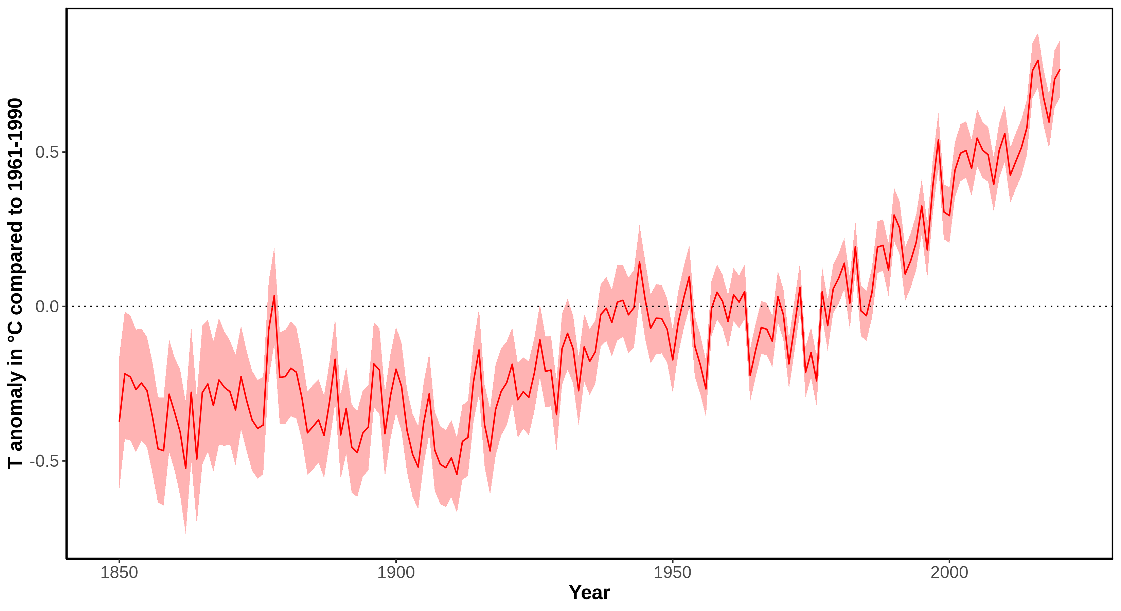
Temperature 1850-2020
Notes:
Message:
In the last 100 years the average world temperature increased of about 1 °C, the temperature increase accelerated in the last 30 years (0.7 °C increase compared to average 1961-1990).
Data:
Data from 1850 onward was obtained from HadCRUT4 (https://www.metoffice.gov.uk/hadobs/hadcrut4/). HadCRUT4 is a gridded dataset of global historical surface temperature anomalies relative to a 1961-1990 reference period. Data are available for each month since January 1850, on a 5 degree grid.
Citation: Morice, C. P., Kennedy, J. J., Rayner, N. A., and Jones, P. D. (2012), Quantifying uncertainties in global and regional temperature change using an ensemble of observational estimates: The HadCRUT4 data set, J. Geophys. Res., 117, D08101, doi:10.1029/2011JD017187.
Download global yearly data: https://www.metoffice.gov.uk/hadobs/hadcrut4/data/current/time_series/HadCRUT.4.6.0.0.annual_ns_avg.txt.
File format: https://www.metoffice.gov.uk/hadobs/hadcrut4/data/current/series_format.html.
Additional information, data and code to generate this plot is available at https://github.com/fmenardo/2minutes4future.

Slide 2
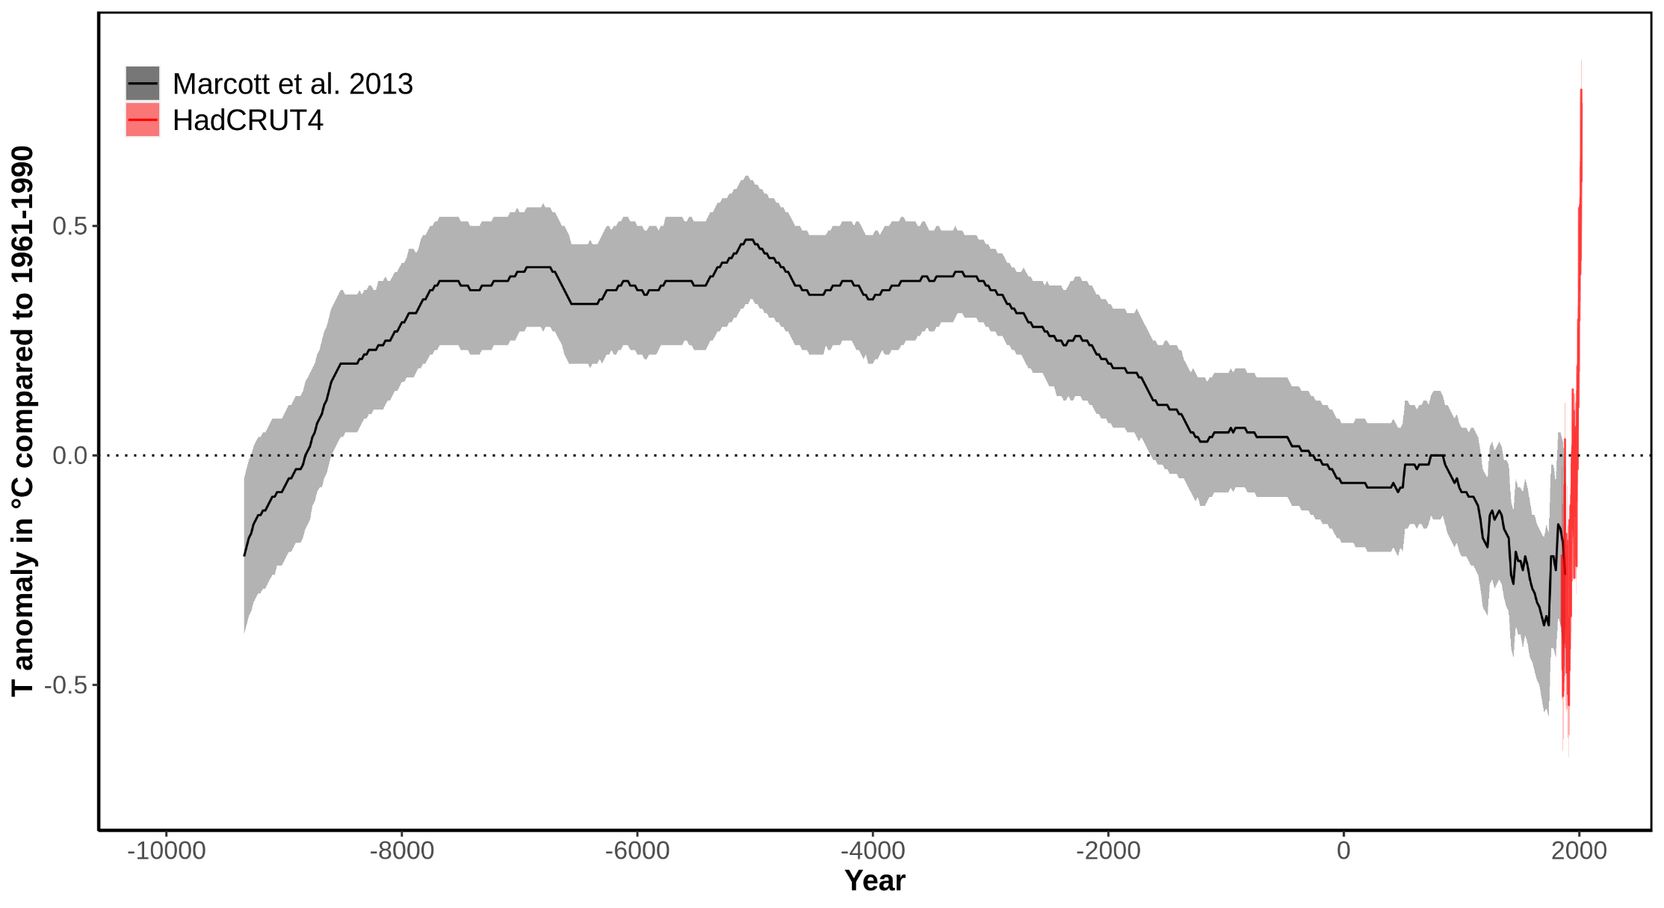
Temperature 9300BCE - 2020
Notes:
Message:
Early Holocene was characterized by increasing temperature, which stabilized for about 5,000 years (Holocene climate optimum). After that a cooling trend prevailed, and culminated around 200 years ago in the little ice age, which was the coldest period of the Holocene.
In the last 100 years the average world temperature increased of about 1 °C, the temperature increase accelerated in the last 30 years (0.7 °C increase). Global temperatures are now higher than the average during the Holocene climate optimum.
Data:
Data from 1850 onward was obtained from HadCRUT4 (https://www.metoffice.gov.uk/hadobs/hadcrut4/). HadCRUT4 is a gridded dataset of global historical surface temperature anomalies relative to a 1961-1990 reference period. Data are available for each month since January 1850, on a 5 degree grid.
Citation: Morice, C. P., Kennedy, J. J., Rayner, N. A., and Jones, P. D. (2012), Quantifying uncertainties in global and regional temperature change using an ensemble of observational estimates: The HadCRUT4 data set, J. Geophys. Res., 117, D08101, doi:10.1029/2011JD017187.
Download global yearly data: https://www.metoffice.gov.uk/hadobs/hadcrut4/data/current/time_series/HadCRUT.4.6.0.0.annual_ns_avg.txt.
File format: https://www.metoffice.gov.uk/hadobs/hadcrut4/data/current/series_format.html.
Long term data (for the last ~11,300 years) was obtained from Marcott et al. 2013. These estimates are based on 73 globally distributed paleoclimate archives and temperature proxies, with sampling resolutions ranging from 20 to 500 years, and a median resolution of 120 years.
An important limitation of this data is that it does not fully resolve variability at periods shorter than 2000 years, with essentially no variability preserved at periods shorter than 300 years, ~50% preserved at 1000-year periods, and nearly all of the variability preserved for periods longer than 2000 years. The plot is based on the global 5x5 grid, and the shaded are represent 1σ uncertainty.
Citation: A Reconstruction of Regional and Global Temperature for the Past 11,300 Years Shaun A. Marcott et al. Science 339 , 1198 (2013); DOI: 10.1126/science.1228026.
Download data from supplementary table S1: https://science.sciencemag.org/highwire/filestream/594506/field_highwire_adjunct_files/1/Marcott.SM.database.S1.xlsx.
Additional information, data and code to generate this plot is available at https://github.com/fmenardo/2minutes4future.

Slide 3
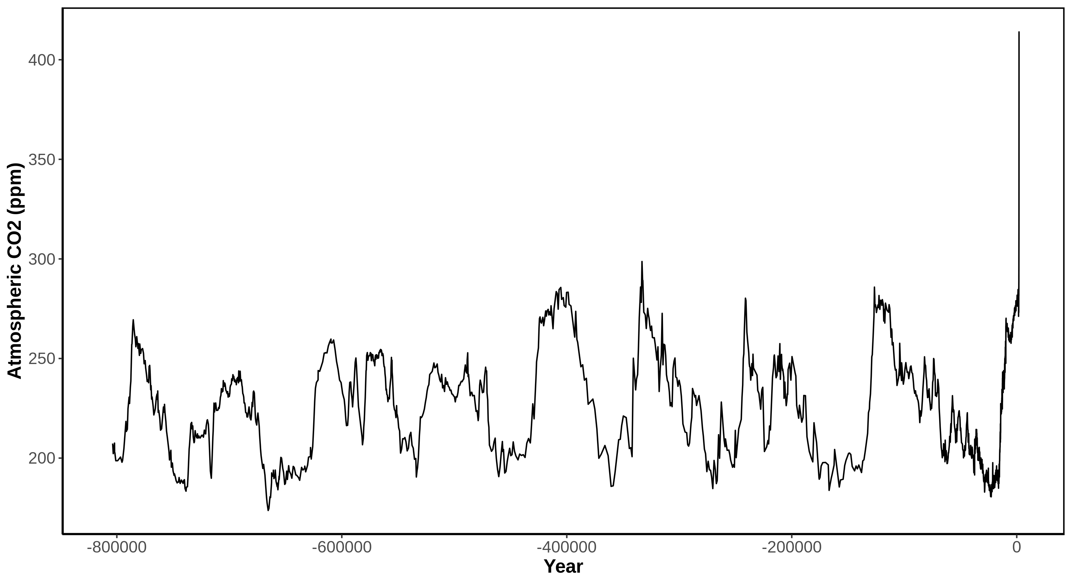
Temperature 800.000 years
Notes:
Message:
For the last 800 thousands year, the atmospheric CO2 concentration oscillated between ~150 and 300 ppm. The periods with low CO2 concentration were ice ages, the last of which between ~115,000 and 12,000 years ago. The periods between ice ages, with higher CO2 concentration, are warmer interglacial periods. In the last 60 years the concentration of CO2 in the atmosphere increased drastically. 1960: 317 ppm; 1980: 339 ppm; 2000: 370 ppm; 2020: 414 ppm.
Data:
Data from 1959 through 1979 have been obtained by C. David Keeling of the Scripps Institution of Oceanography (SIO) and were obtained from the Scripps website (scrippsco2.ucsd.edu). Data from 1980 onwards is sourced from NOAA's Mauna Loa monitoring station. These are direct measurements.
Download: https://www.esrl.noaa.gov/gmd/webdata/ccgg/trends/co2/co2_annmean_mlo.txt
Long-term data (~800,000 BC - 1958 AD) derives from ice cores – specifically the Dome C core – and has been made available from the NOAA here: https://www.ncdc.noaa.gov/paleo-search/study/17975. The data was compiled by Our world in data: some years had multiple measurements (taken at different points of the year). To normalize this to a single year, where several measurements were available, we took the average of these concentration values. Dome C data has been used until the year 1958.
Citation: Bereiter, B., Eggleston, S., Schmitt, J., Nehrbass‐Ahles, C., Stocker, T. F., Fischer, H., ... & Chappellaz, J. (2015). Revision of the EPICA Dome C CO2 record from 800 to 600 kyr before present. Geophysical Research Letters, 42(2), 542-549.
Download: https://ourworldindata.org/co2-and-other-greenhouse-gas-emissions/
Additional information, data and code to generate this plot is available at https://github.com/fmenardo/2minutes4future.

Slide 4
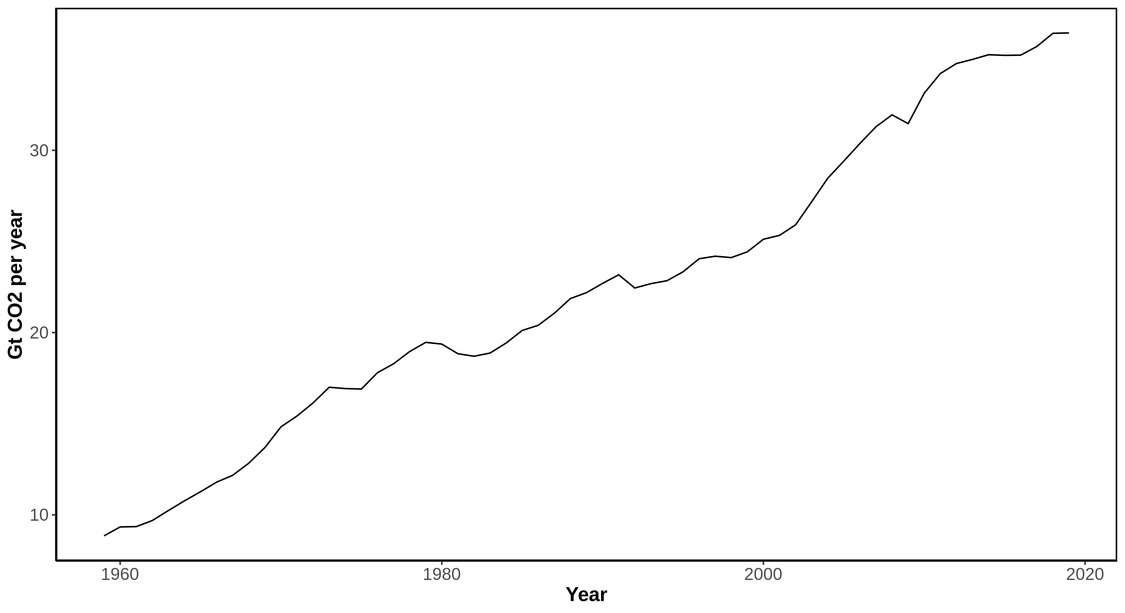
Annual CO₂ emissions 1960-2020
Notes:
Message:
The fast increase in CO2 concentration in the atmosphere is caused by anthropogenic emissions, due to combustion of fossil fuels, deforestation (not included in the plot) and other industrial processes.
Every years humanity release more CO2 in the atmosphere, and there is an increasing trend. 2019 was the years with most CO2 emissions on record, almost four times the emissions of 1960.
The data for 2020 is still provisional, the Emission Gap Report predict a decrease of emissions of about 2-4 Gt compared to 2019 (~10%), corresponding approximately to the level of 2010.
Emission Gap Report (United Nation Environment Programme): https://wedocs.unep.org/xmlui/bitstream/handle/20.500.11822/34426/EGR20.pdf?sequence=1&isAllowed=y.
Data:
Data obtained from Friedlingstein et al. 2020. It includes emissions from fossil fuel combustion, oxidation, and cement production.
Citation: Friedlingstein et al. 2020. Earth Syst. Sci. Data, 12, 3269–3340, 2020 https://doi.org/10.5194/essd-12-3269-2020
Download: https://data.icos-cp.eu/licence_accept?ids=%5B%22xUUehljs1oTazlGlmigAhvfe%22%5D
Additional information, data and code to generate this plot is available at https://github.com/fmenardo/2minutes4future.

Slide 5
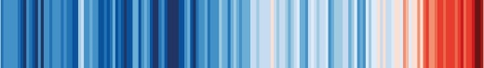
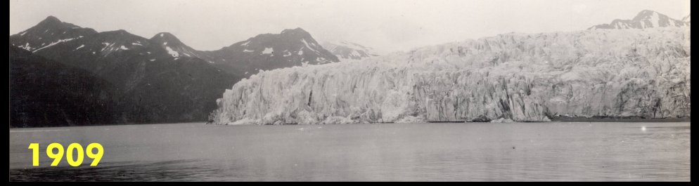
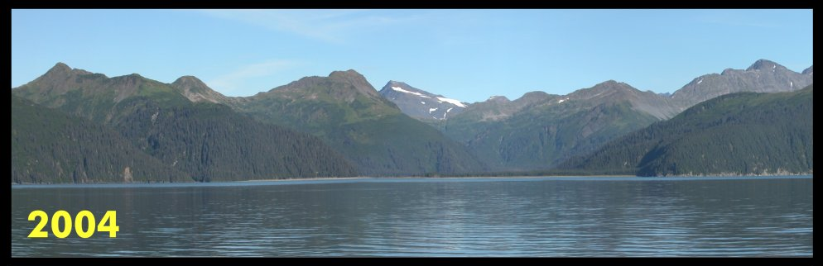
2 Slides for Future: The Problem
scientists4future.ch
McCarthy-Glacier (Alaska)
Not really a problem for „the planet“, but…
Notes:
SPEAKER_NOTES:
VARIANT: GERMAN
NOTES: Retreating Glacier in Alaska
CREDITS: © Arrangement G. Hagedorn, CC0, Both images Public Domain (via Commons)
SOURCES: https://commons.wikimedia.org/wiki/File:McCarty_Glacier.jpg, Image cropped and re-arranged.
REVIEWED_BY:

Slide 6
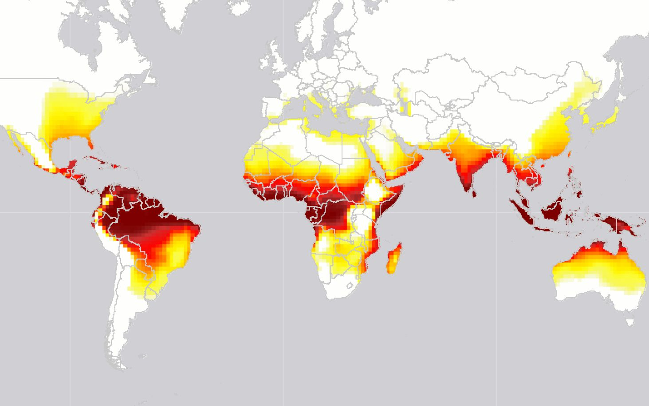

2 Slides for Future: The Problem
scientists4future.ch
Days of deadly heat in 2100
365
0
(IPCC RCP 8.5 for 2100, after Mora et al., 2017)
Notes:
SPEAKER_NOTES:
VARIANT: GERMAN
CREDITS: © Gregor Hagedorn, CC BY-SA 4.0. Data for IPCC RCP 8.5, after Mora et al. 2017 Nature Climate Change.
SOURCES: Robert McSweeney 19 June 2017. Billions to face ‘deadly threshold’ of heat extremes by 2100, finds study. Carbonbrief, https://www.carbonbrief.org/billions-face-deadly-threshold-heat-extremes-2100-study
Article based on Mora, C. et al. (2017) Global risk of deadly heat, Nature Climate Change, doi:10.1038/nclimate3322
COPYRIGHT: Simple map data visualization after Robert McSweeney 19 June 2017, below copyright threshold.
REVIEWED_BY:

Slide 7
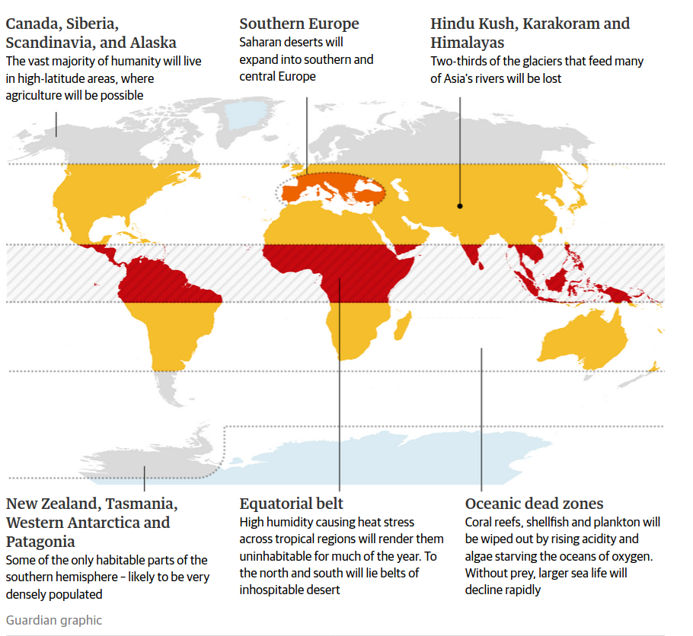
2 Slides for Future: The Problem
scientists4future.ch
Possible
consequences
for +4°C average
in 2100:
https://www.theguardian.com/environment/2019/may/18/climate-crisis-heat-is-on-global-heating-four-degrees-2100-change-way-we-live

Slide 8
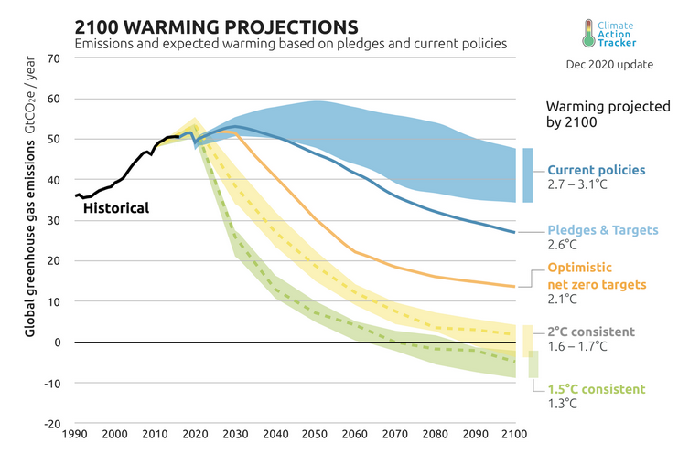
2 Slides for Future: The Problem
scientists4future.ch

Slide 9
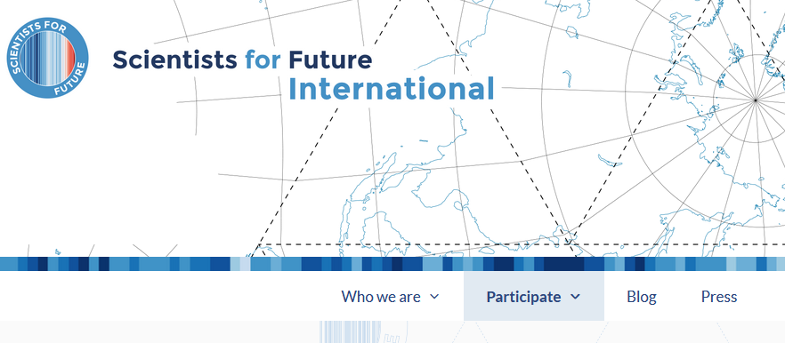
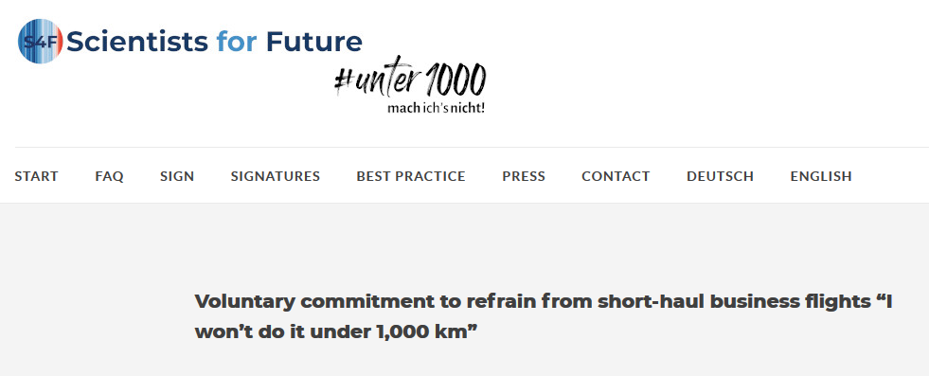
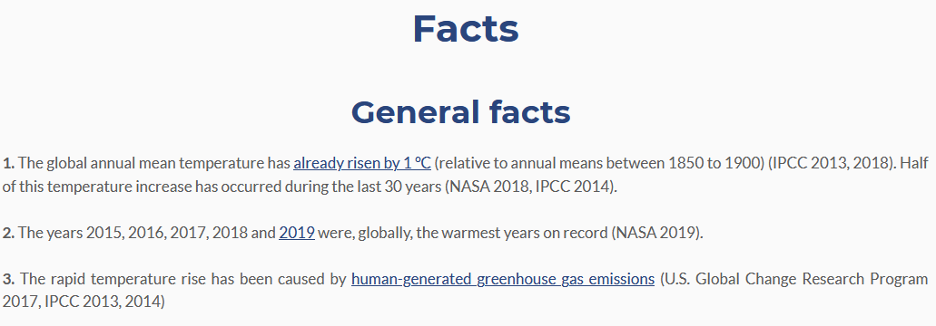
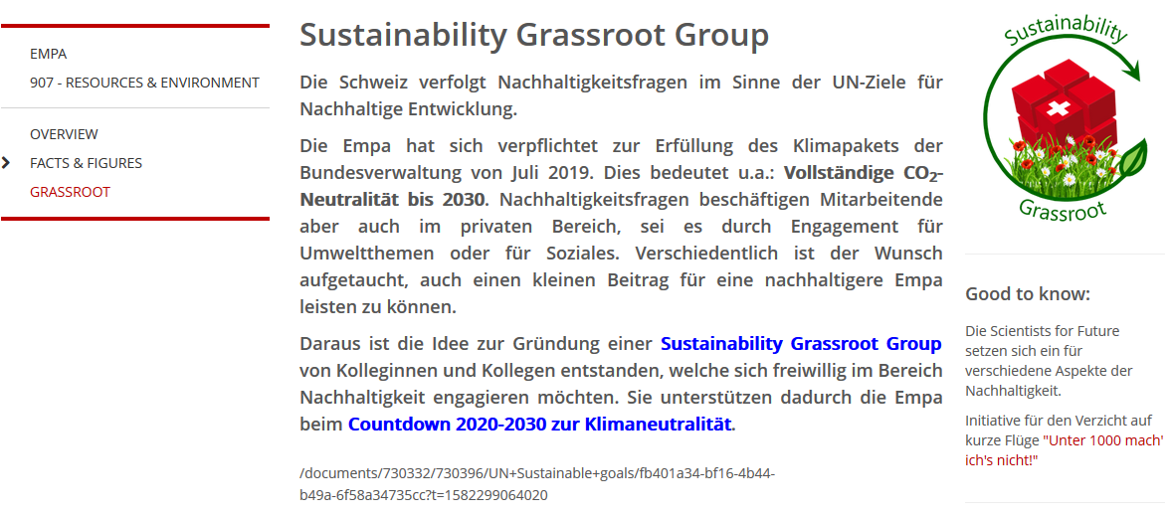

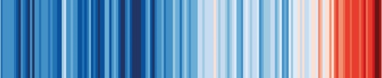
2 Slides for Future: Action Items
scientists4future.ch
Get smart!
scientists4future.org
Get engaged!
Personal goal
Join a movement
Raise awareness – spread the word!
2slides4future.com
2slides4future.org
Notes:
Option: replace top

