Slide 1


But first: a word about Climate Change!
1880
1900
1920
1940
1960
1980
2000
2020
ΔT [K] vs AVG(1880-1910)
1st 0.5 K > 100 a; 2nd 0.5 K < 30 a
Source: NASA
Year AD

Slide 2
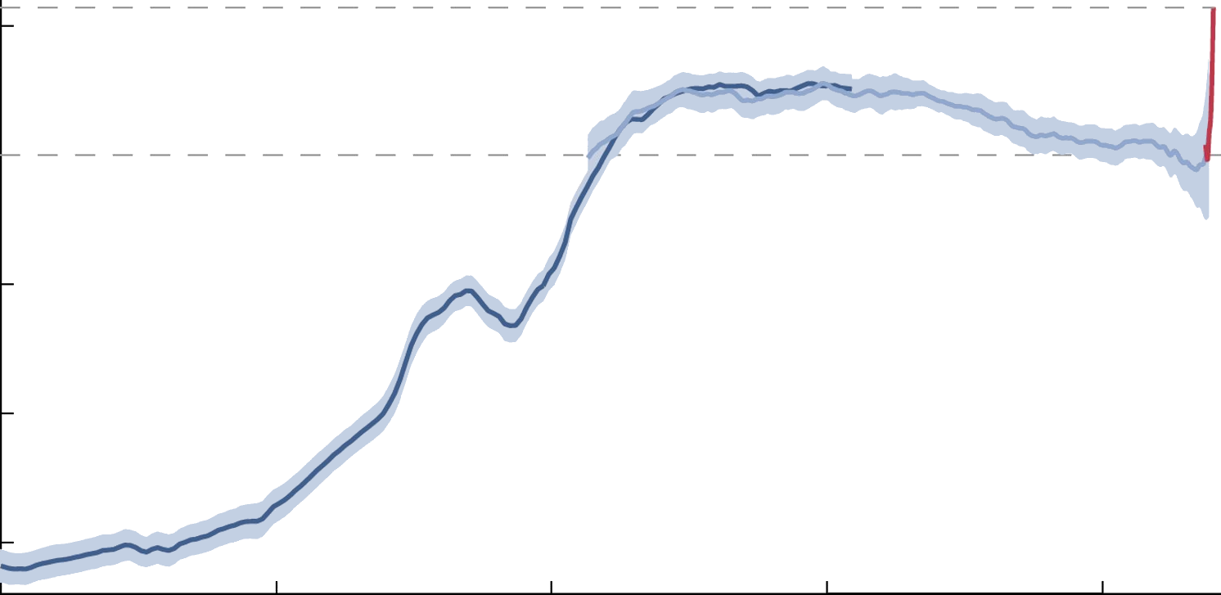
Temperature Change (mid-term)
Hockey-Stick Curve
1
ΔT [K] vs AVG(1880-1910)
0
Little Ice Age
-1
Last Ice Age
Holocene [from the last ice age to now]
-2
-3
Year AD
-20,000
-15,000
-10,000
-5,000
0
2,000

Slide 3
Climate Change (long-term)
400
CO₂ [ppm]
Keeling Curve
300
250
200
ppm
+2
ΔT [°C]
Holocene
0
Last Ice Age
- 2
- 4
°C
T[a]
-400,000
Sea Levels [m]
0
-300,000
-200,000
-100,000
0
–75
–150
m
T[a]
-400,000
-300,000
-200,000
-100,000
0
After: Gregor Hagedorn, Franz Bauer, Johannes Etzkorn, CC BY-SA 4.0, adapted from John Englander, and Hansen & Sato [Link]

Slide 4
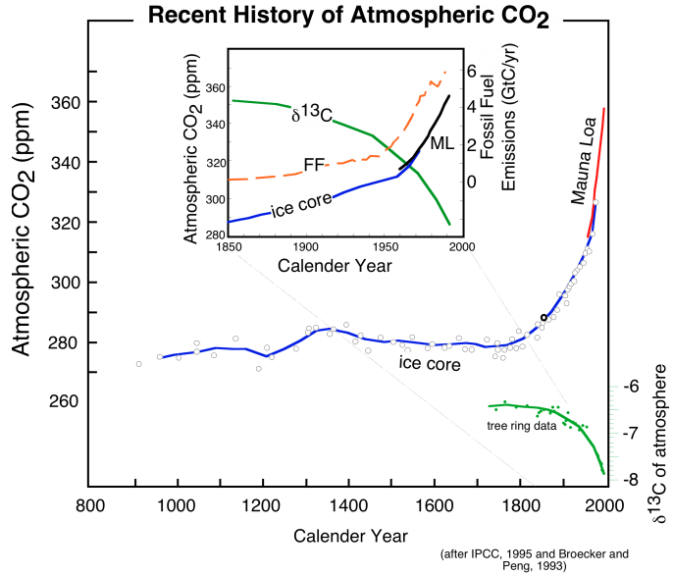
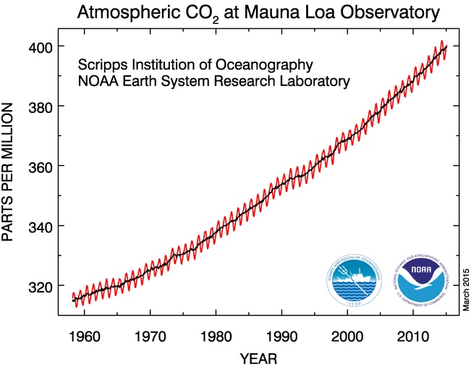
CO₂ Problem Explained
400
CO₂ [ppm]
Keeling Curve
300
250
200
ppm
-400,000
-300,000
-200,000
-100,000
0
Link
Link
[Link]

Slide 5
CO₂ Problem Explained
IPCC: The carbon contained in CO² has two naturally occurring stable isotopes denoted ¹²C and ¹³C. The first of these, ¹²C, is the most abundant isotope at about 99%, followed by ¹³C at about 1%. Emissions of CO² from coal, gas and oil combustion and land clearing have ¹³C/¹²C isotopic ratios that are less than those in atmospheric CO², and each carries a signature related to its source. Thus, as shown in Prentice et al. (2001), when CO² from fossil fuel combustion enters the atmosphere, the 13^{C}/12^{C} isotopic ratio in atmospheric CO² decreases at a predictable rate consistent with emissions of CO² from fossil origin. [IPCC AR4, WG1, CH 2-1, p 139, Link]
¹³C is rare in fossil fuels
¹³C is rare in fossil fuels
→ Climate Change is Man-Made!
Link
Link
[Link]

